Slide 1
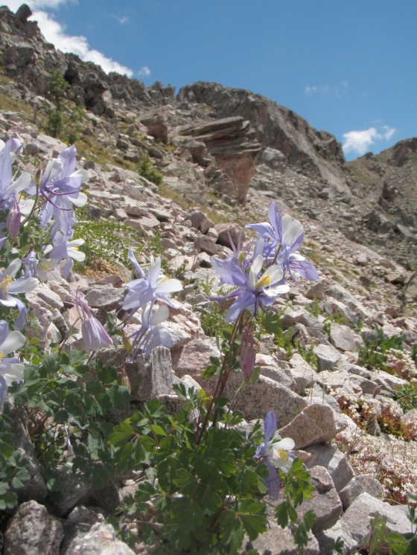
What limits Southern Rockies pika distribution?
Liesl Peterson Erb
Ph.D. Candidate
Ecology and Evolutionary Biology
Liesl.Erb@Colorado.edu
Photos courtesy of Justine Smith

Slide 2
How can pikas be affected by climate?
Courtesy of Dr. Chris Ray

Slide 3
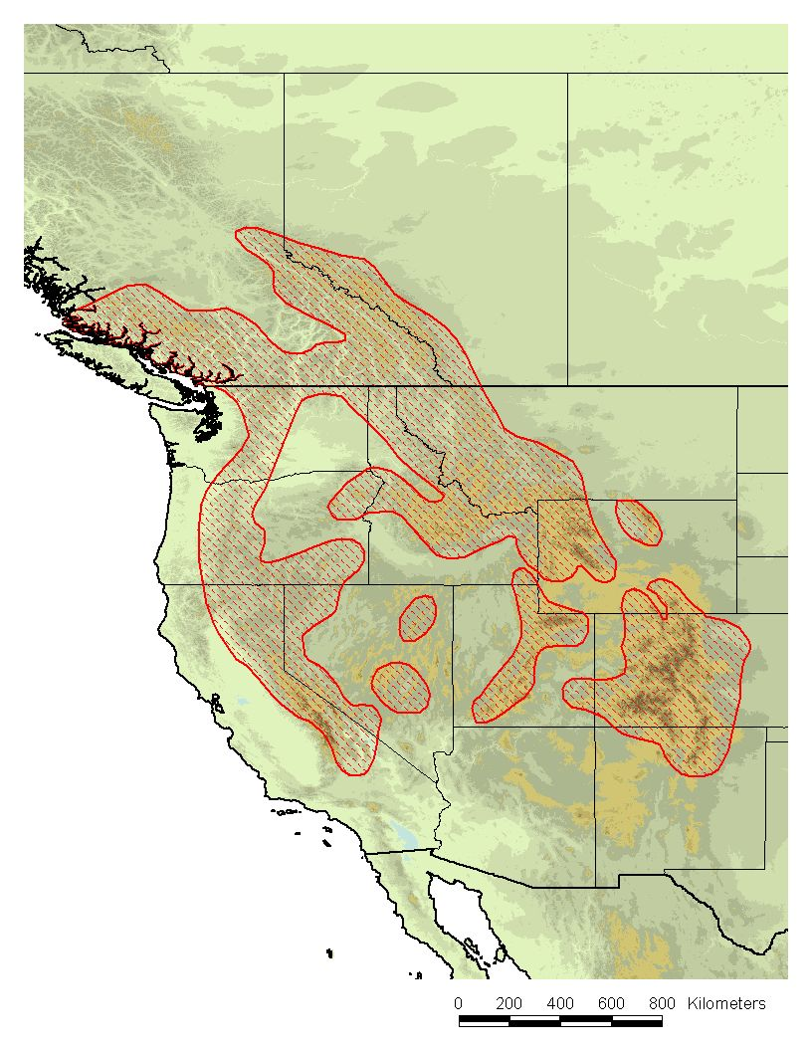
Ochotona princeps distribution
25 historical populations
recorded 1898-1990
(average date = 1933)
6 extinct by 1999 (►)
10 by 2008 (◄)
Extinction rate is rising
Beever et al. 2011, Global Change Biology

Slide 4
Ochotona princeps distribution
25 historical populations
recorded 1898-1990
(average date = 1933)
6 extinct by 1999 (►)
10 by 2008 (◄)
Extinction rate is rising
Best Predictors:
Chronic heat stress
Acute cold stress
Beever et al. 2011, Global Change Biology

Slide 5
Great Basin vs. Southern Rockies
Less overall habitat
Lower elevation
Isolated pika populations
More overall habitat
Higher elevation
More connectivity between populations?
Notes:
GB valley floor ~3000 ft
5

Slide 6
Great Basin vs. Southern Rockies
Less overall habitat
Lower elevation
Isolated pika populations
More overall habitat
Higher elevation
More connectivity between populations?
10,000 feet
Notes:
GB valley floor ~3000 ft; point being: if they’re doing poorly here, we REALLY have a problem.
6

Slide 7
What about the Southern Rockies?
?
Trends here could determine the fate of the species
Notes:
More habitat, some of the southern-most habitat
7

Slide 8
Research Questions
How has modern climate change impacted the distribution and abundance of O. princeps in the Southern Rocky Mountains?
Current distribution?
Trends in distribution?
Are populations stable?
What factors are driving changes in distribution and/or abundance?
Notes:
8

Slide 9
Study Area
The Southern Rockies
Laramie, WY
to Santa Fe, NM
~430 miles
Western CO border
to the plains
~250 miles
Notes:
9

Slide 10
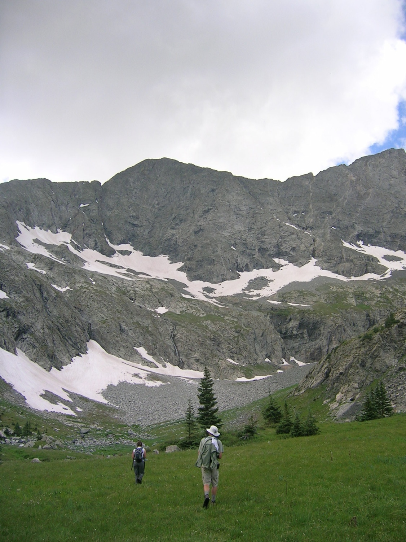
Methods: Determining changes in distribution
Resurvey of historically occupied sites
Historical records (1896-1979)
Notes:
GBIF
10

Slide 11
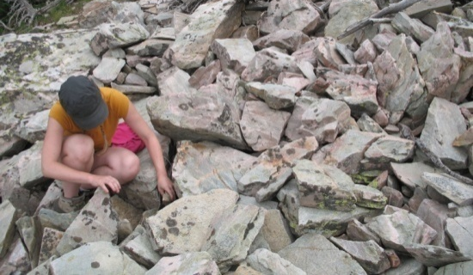
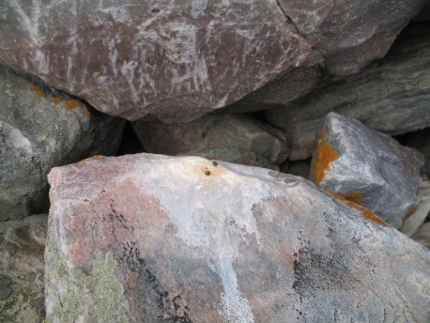
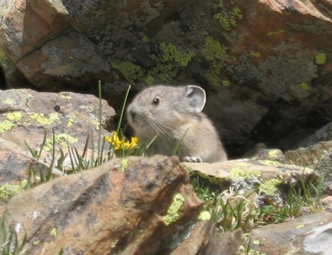
Methods:
Pika occupancy
Visual confirmation
Calls
Fresh haypiles
Scat haypiles
Site characteristics
Talus properties
Slope/aspect
Vegetation
Notes:
11

Slide 12
Today’s Activity:
Develop hypotheses about pika distribution patterns
Variables to work with:
Elevation
Latitude
Summer high temperature
Yearly precipitation
Presence of water
Talus depth
S- vs. N-facing
Vegetation
Notes:
12

