Slide 1
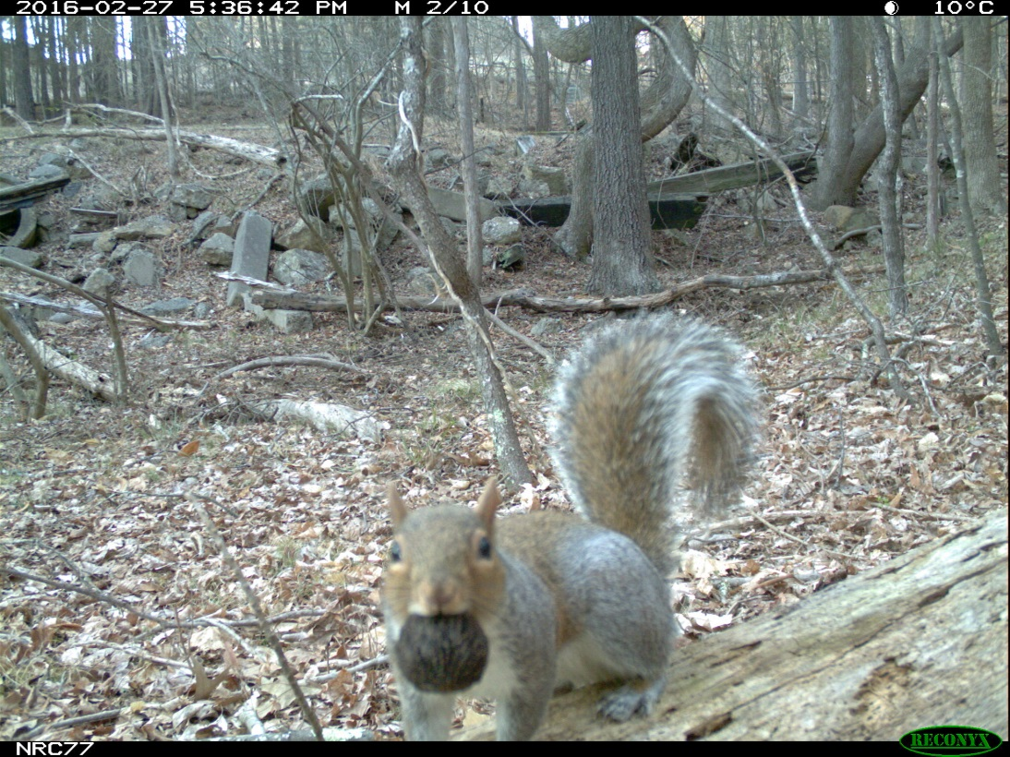
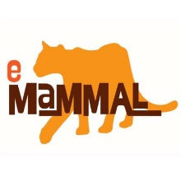
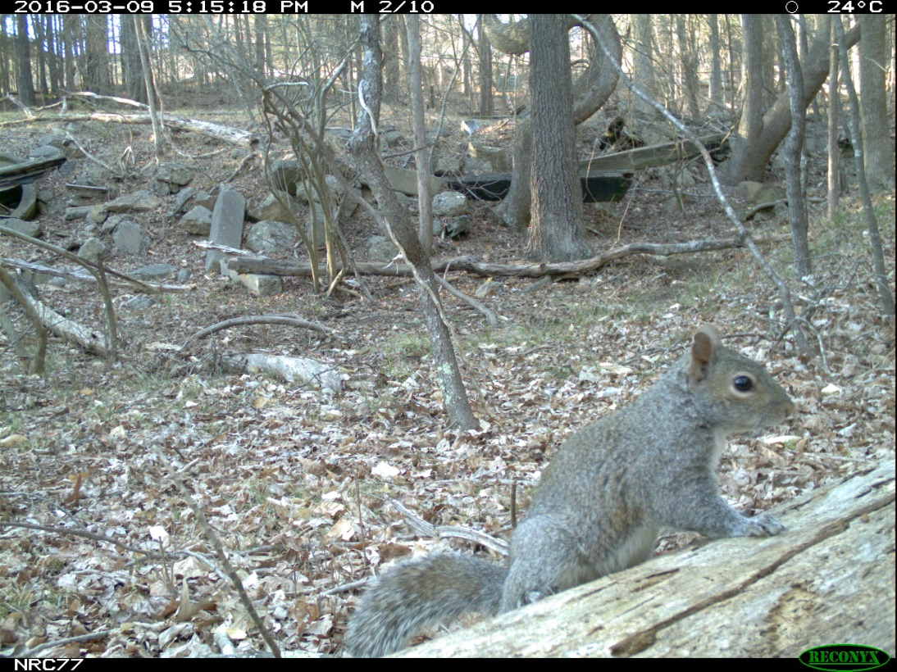
Eastern Gray Squirrel (Sciurus carolinensis)
Photos from the Triangle Camera Trap Survey
Notes:
To accompany STEP 1: The Niche Concept

Slide 2
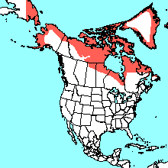
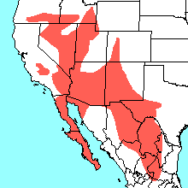
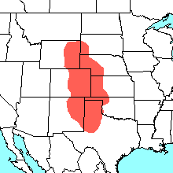
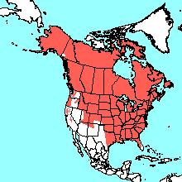
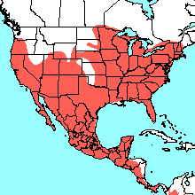
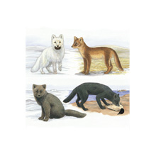
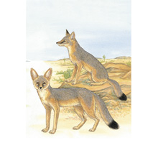
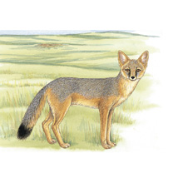
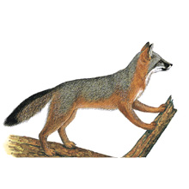
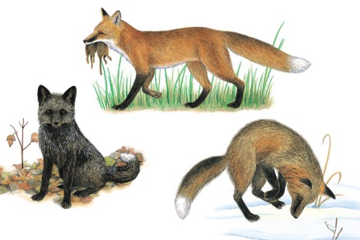
Arctic Fox
(Vulpes lagopus)
Kit Fox
(Vulpes macrotis)
Swift Fox
(Vulpes velox)
Red Fox
(Vulpes vulpes)
Gray Fox
(Urocyon cinereoargenteus)

Slide 3
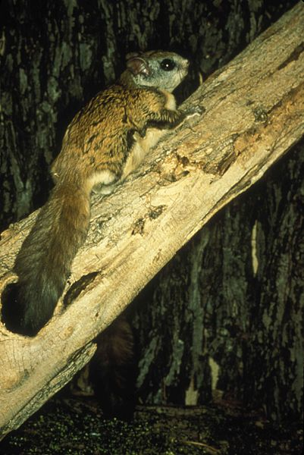
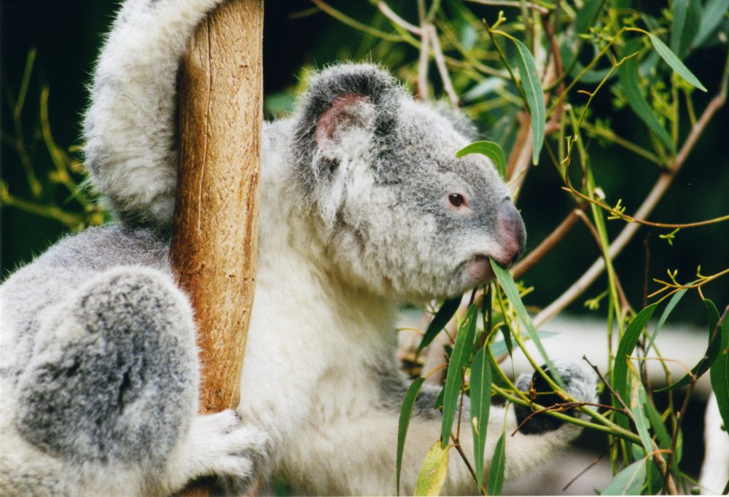
Northern Flying Squirrel
(Glaucomys sabrinus)
Ecological Specialists
Koala
(Phascolarctos cinereus)
© Arnaud Gaillard
Photo by US Fish and Wildlife Service
Notes:
To accompany STEP 3.3: Generalists and Specialists

Slide 4
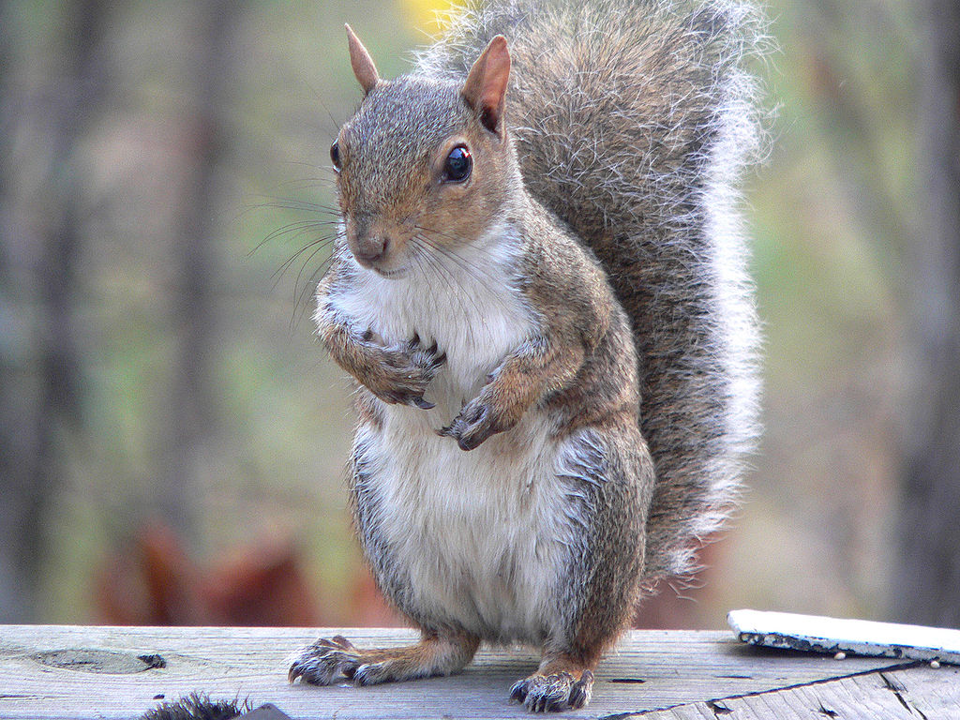
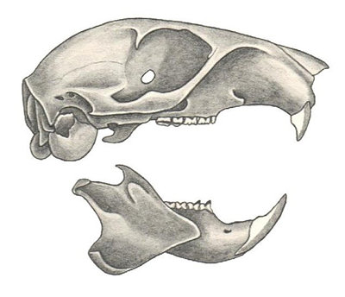
Eastern Gray Squirrel (Sciurus carolinensis)
Ken Thomas - KenThomas.us(personal website of photographer), Public Domain, https://commons.wikimedia.org/w/index.php?curid=1562083
Triangle Camera Trap Survey
Alicia V. Linzey
Notes:
To accompany STEP 6.2: Adaptations

Slide 5
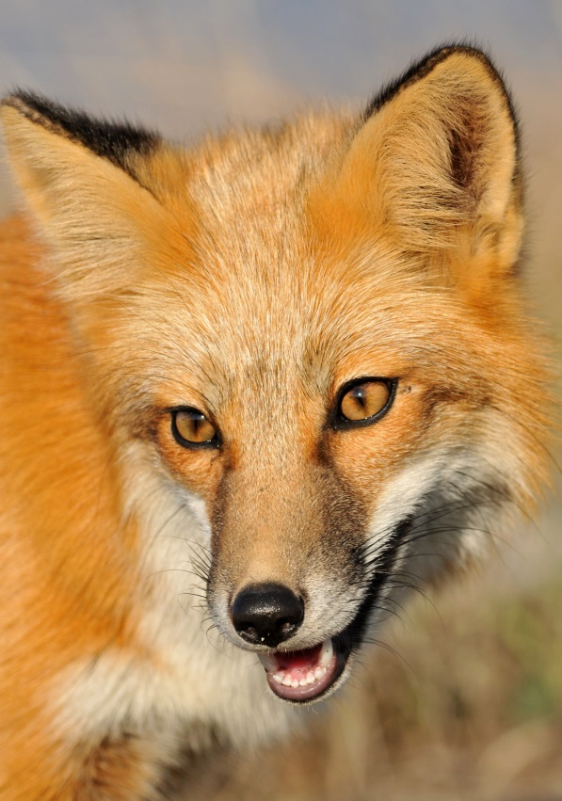
Gary M. Stolz
U.S. Fish and Wildlife Service
© Minette Layne
Notes:
To accompany STEP 6.3: Adaptations

Slide 6
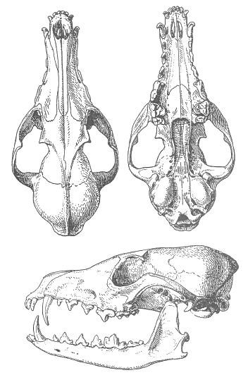
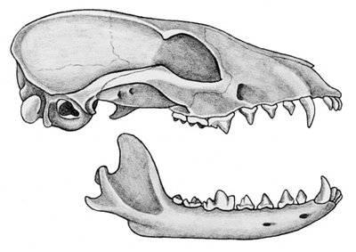
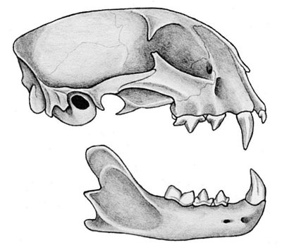
Gray Fox
Red Fox
© Alicia V. Linzey
Bobcat
© Alicia V. Linzey
© N.N. Kondakov
Notes:
To accompany STEP 6.3: Adaptations

Slide 7
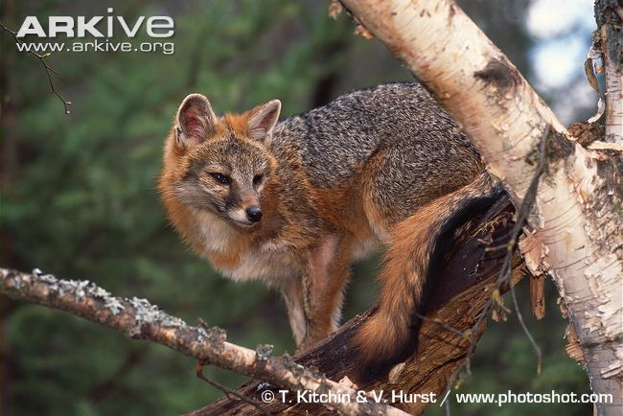
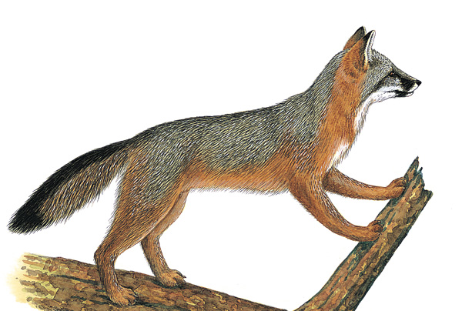
Gray Fox
© N.N. Kondakov
Credit: painting by Consie Powell from Kays and Wilson's Mammals of North America, © Princeton University Press (2002)
Notes:
To accompany STEP 6.3: Adaptations

