Slide 1
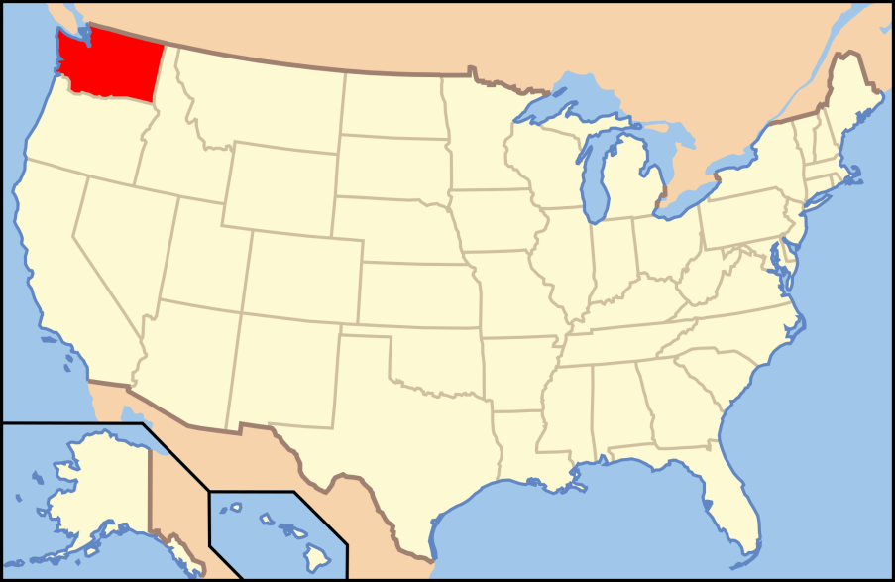
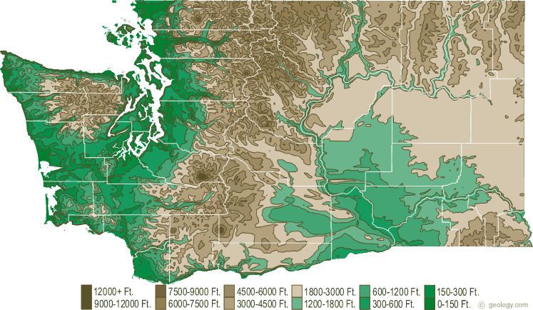
Your pikas live in Washington
Average summer high temperature is 74°F

Slide 2
Your pikas live in Washington
Large pika survival: Medium pika survival: Small pika survival:
66% 50% 33%

Slide 3
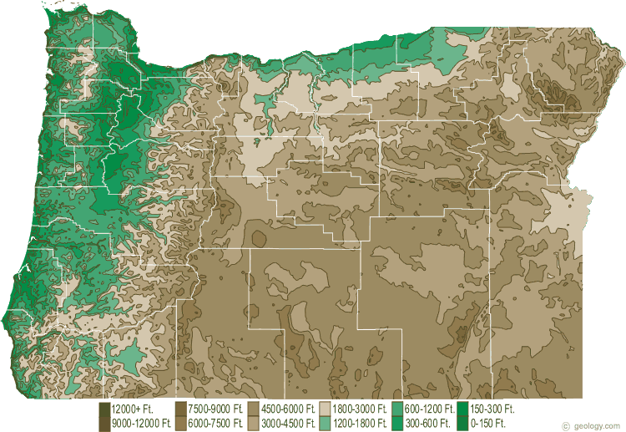
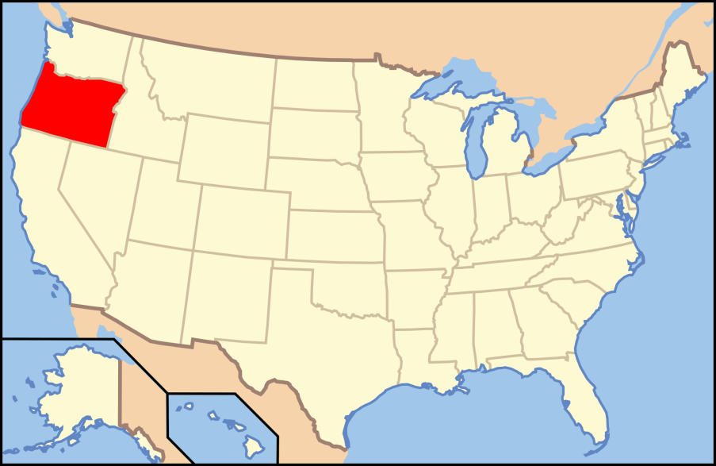
Your pikas live in Oregon
Average summer high temperature is 79°F

Slide 4
Your pikas live in Oregon
Large pika survival: Medium pika survival: Small pika survival:
50% 50% 50%

Slide 5
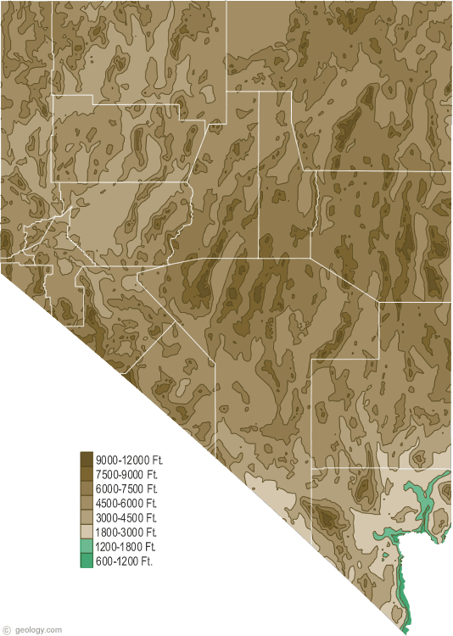
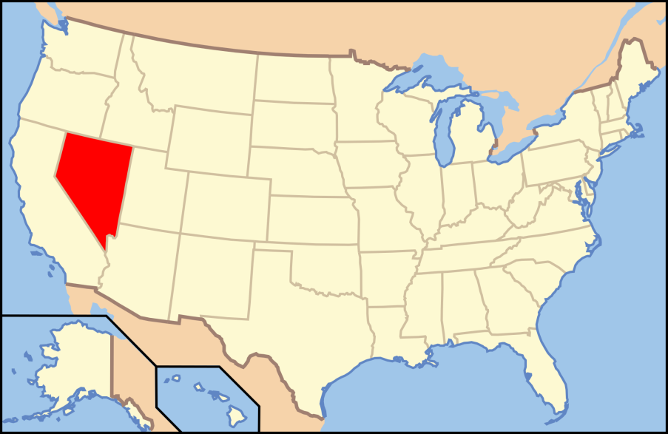
Your pikas live in Nevada
Average summer high temperature is 86°F

Slide 6
Your pikas live in Nevada
Large pika survival: Medium pika survival: Small pika survival:
33% 50% 66%

