Slide 1
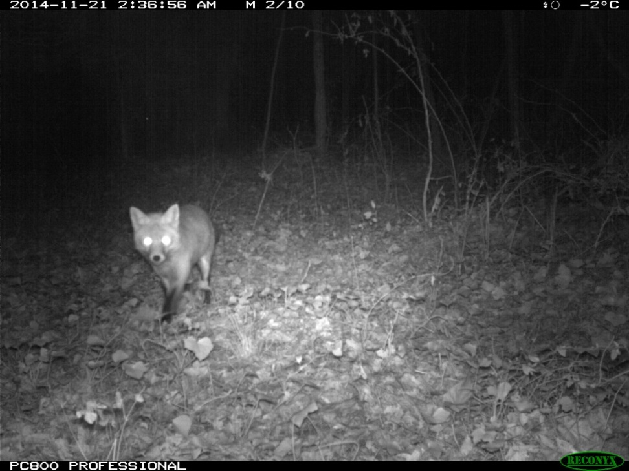
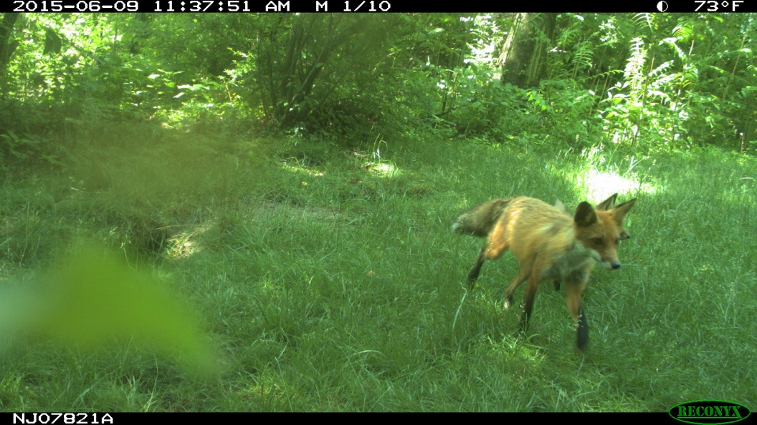
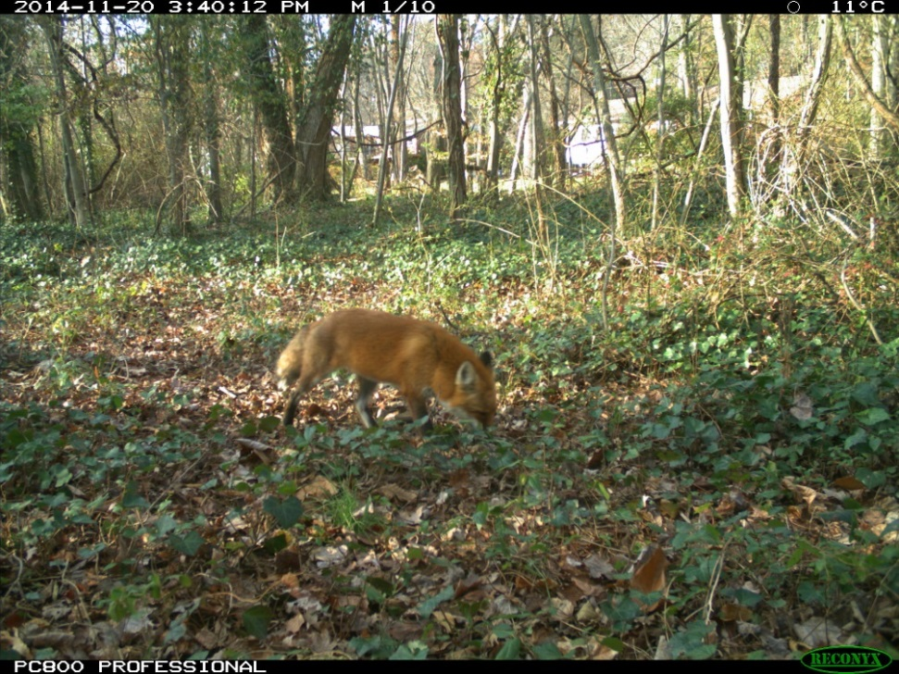
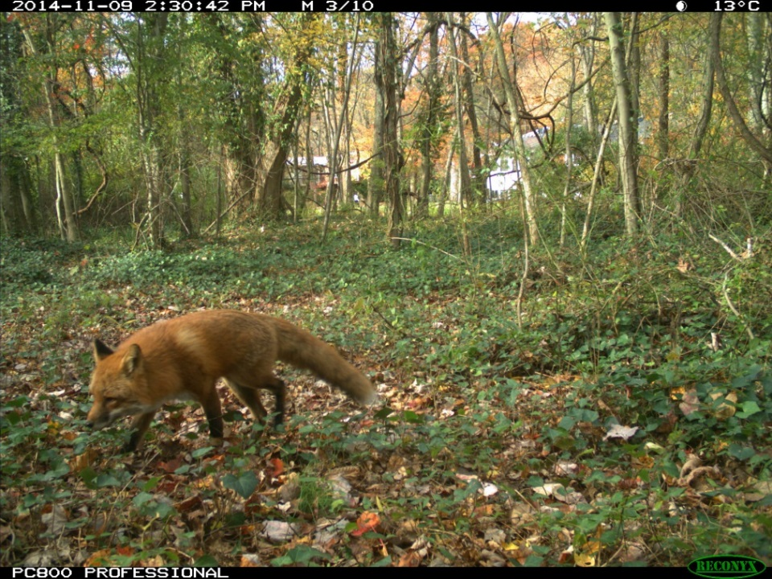
Urban
LESSON 2 - Outfoxed
Notes:
4 red foxes, all from Urban to Wild project

Slide 2
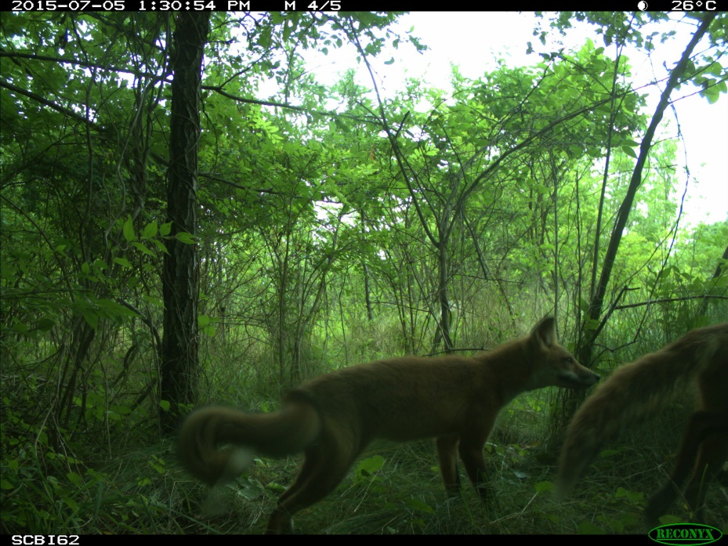
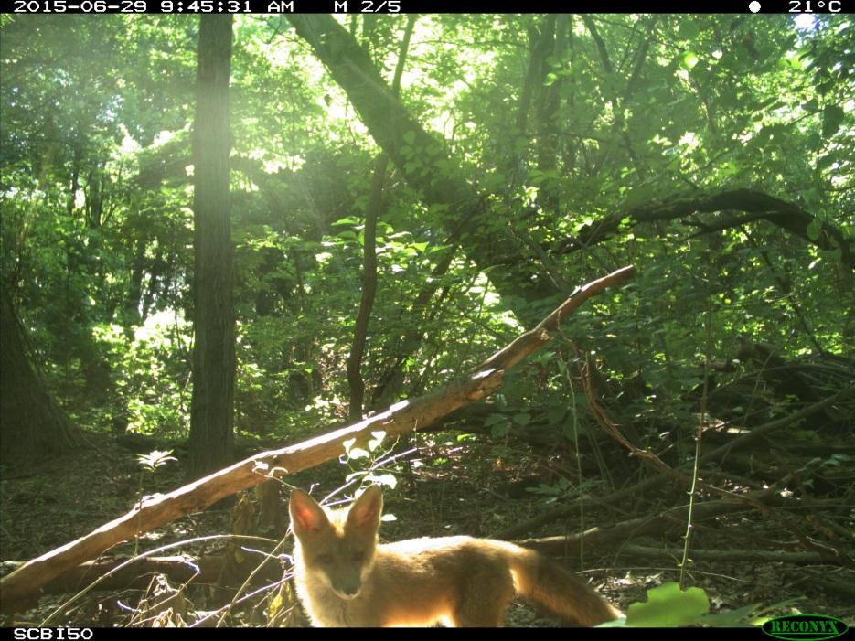
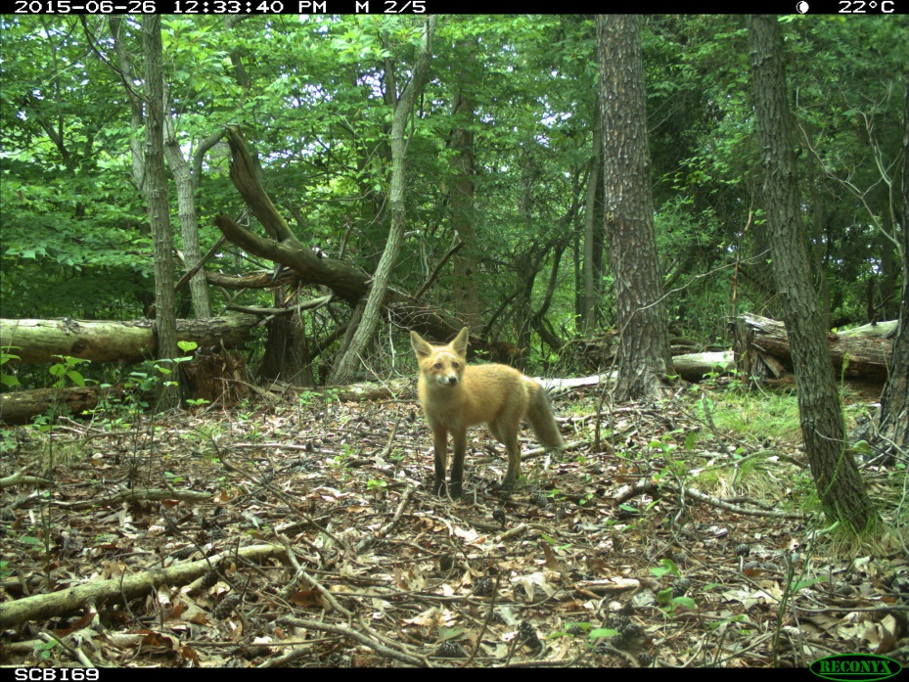
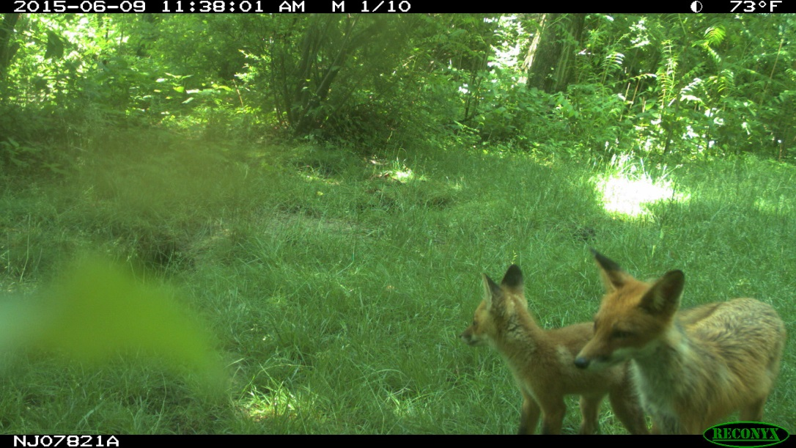
Urban
LESSON 2 - Outfoxed
Notes:
4 red foxes
Bottom right photo from Independent Camera Trap Survey Project; three others from Wildlife in Your Watershed

Slide 3
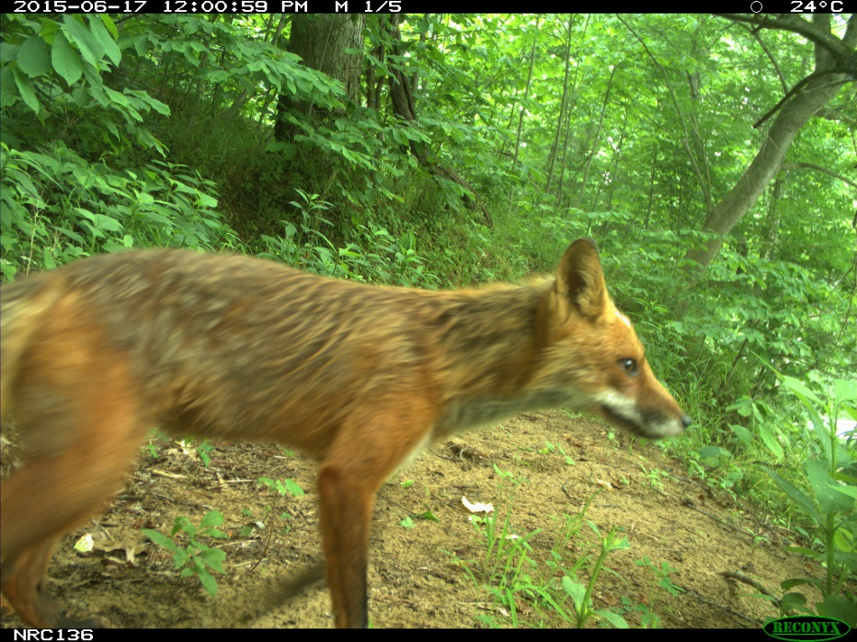
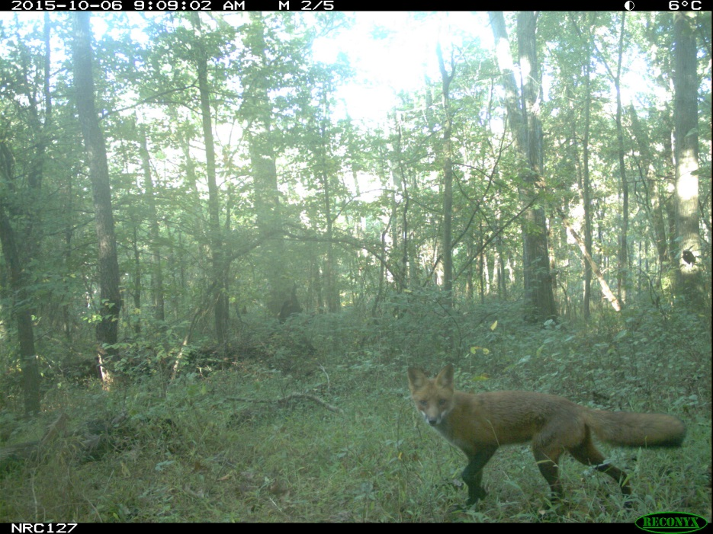
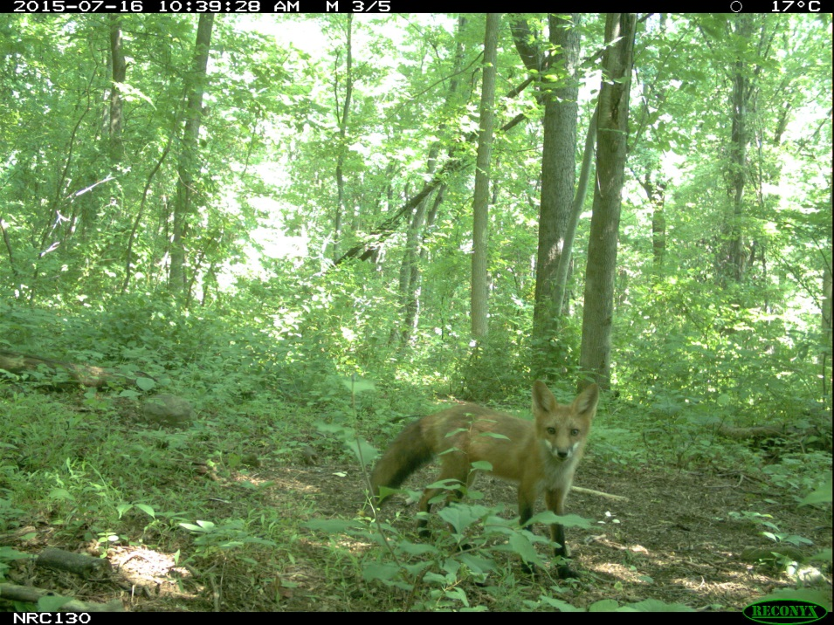
Urban
LESSON 2 - Outfoxed
Notes:
4 red foxes
Bottom right photo from Wildlife in Your Watershed Project; other 3 from Urban to Wild project

Slide 4
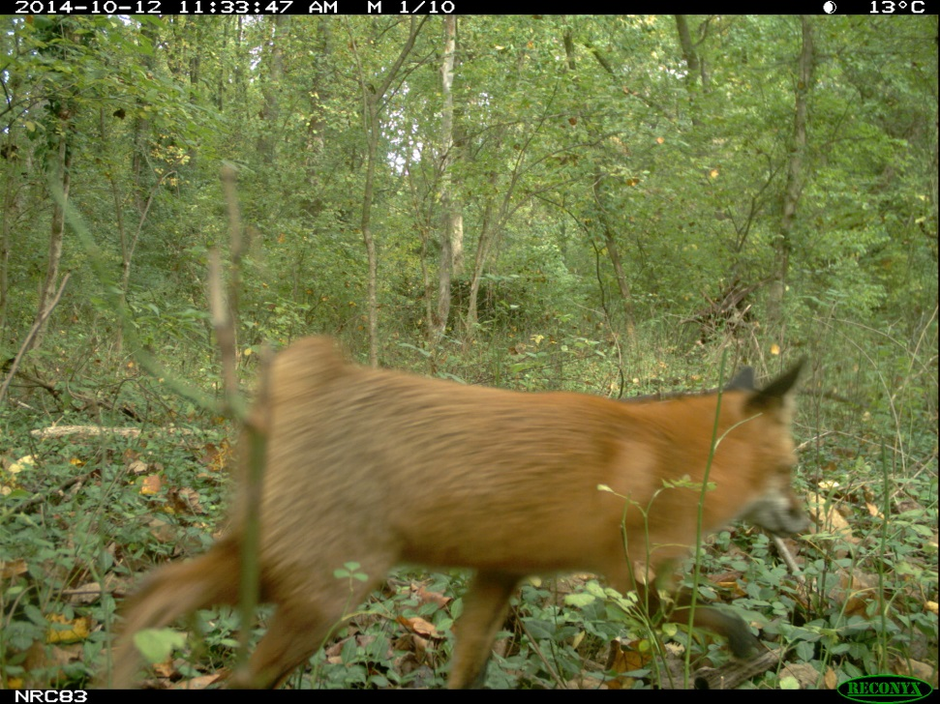
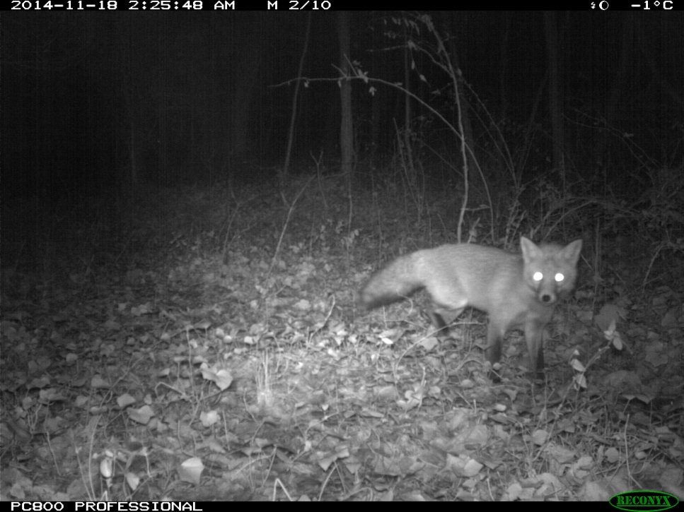
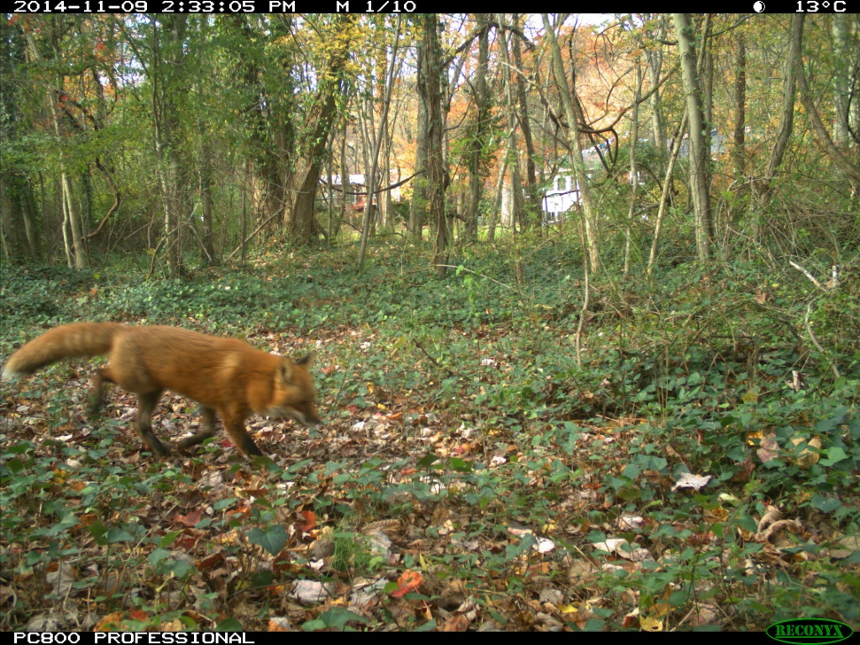
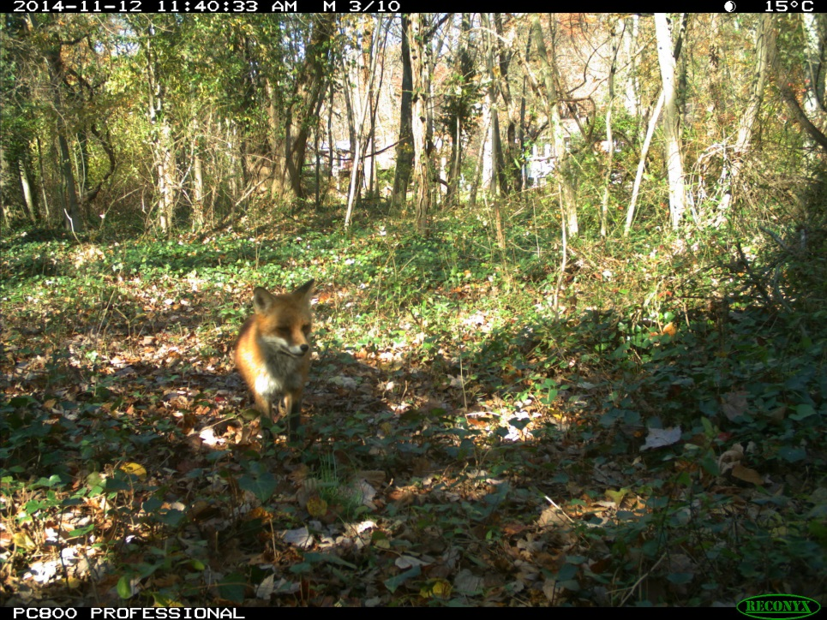
Suburban 1
LESSON 2 - Outfoxed
Notes:
4 red foxes

Slide 5
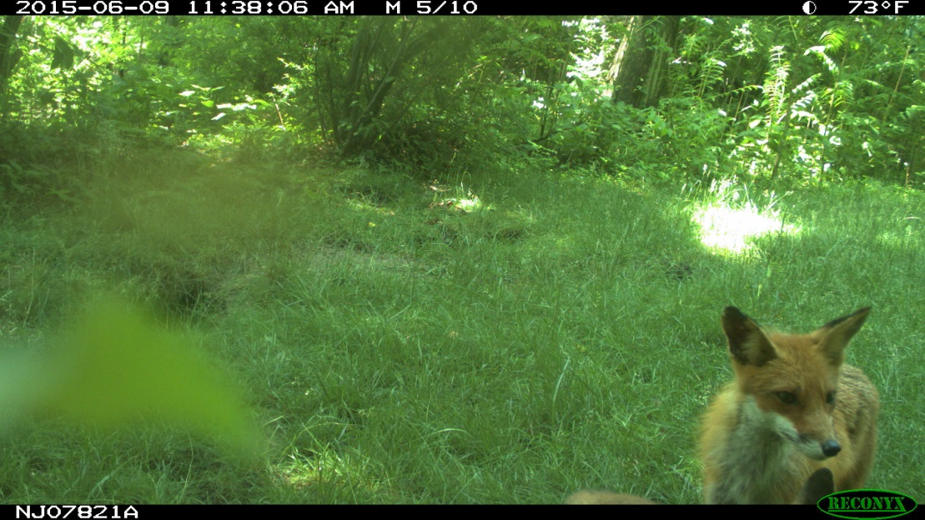
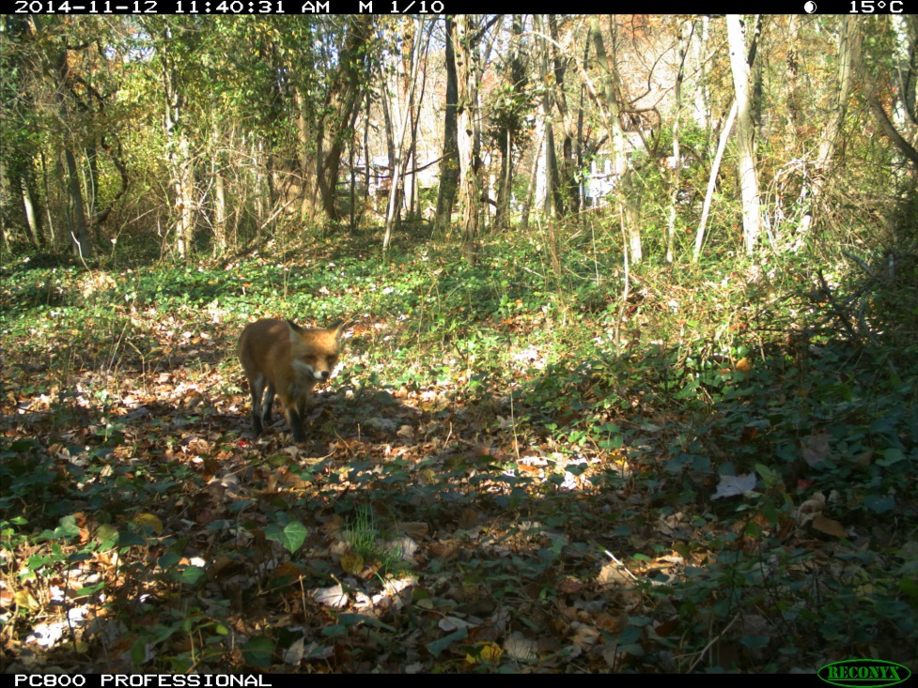
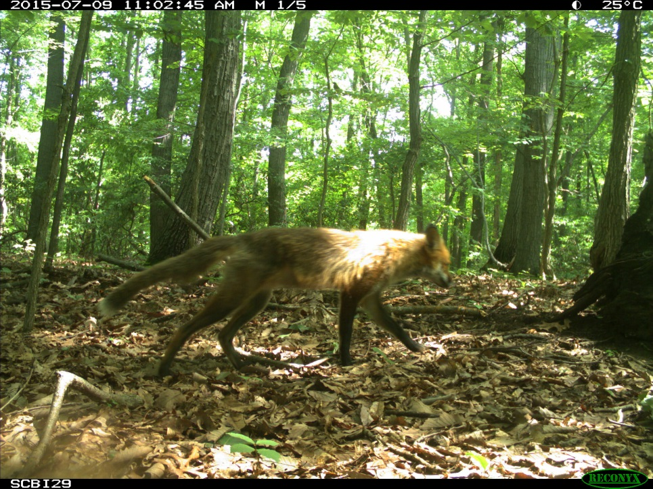
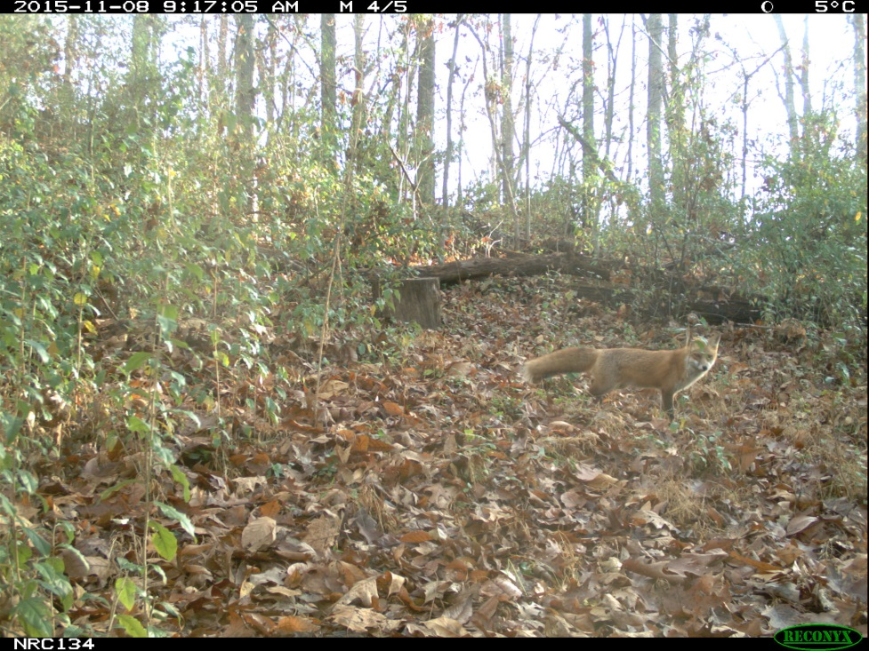
Suburban 2
LESSON 2 - Outfoxed
Notes:
4 red foxes

Slide 6
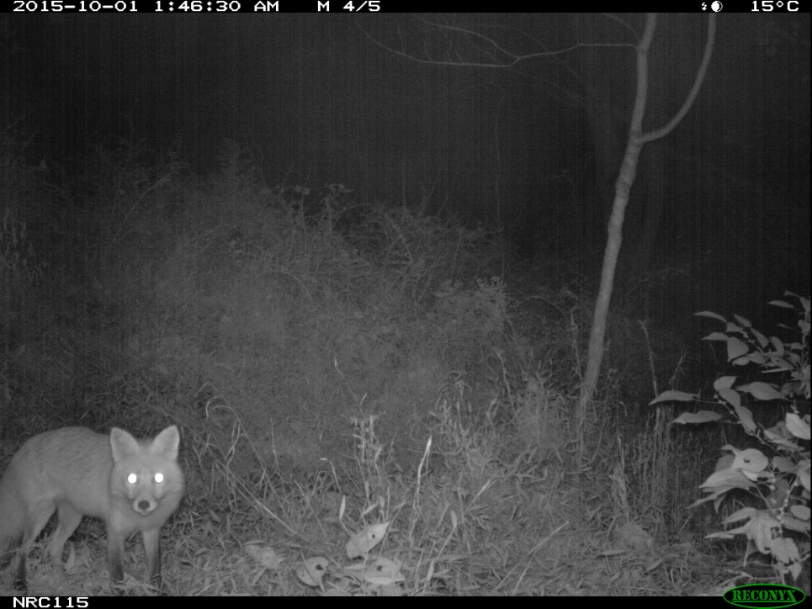
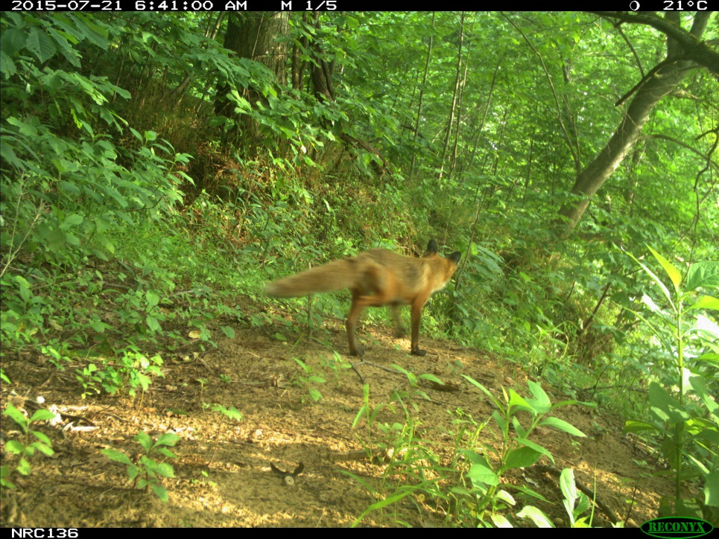
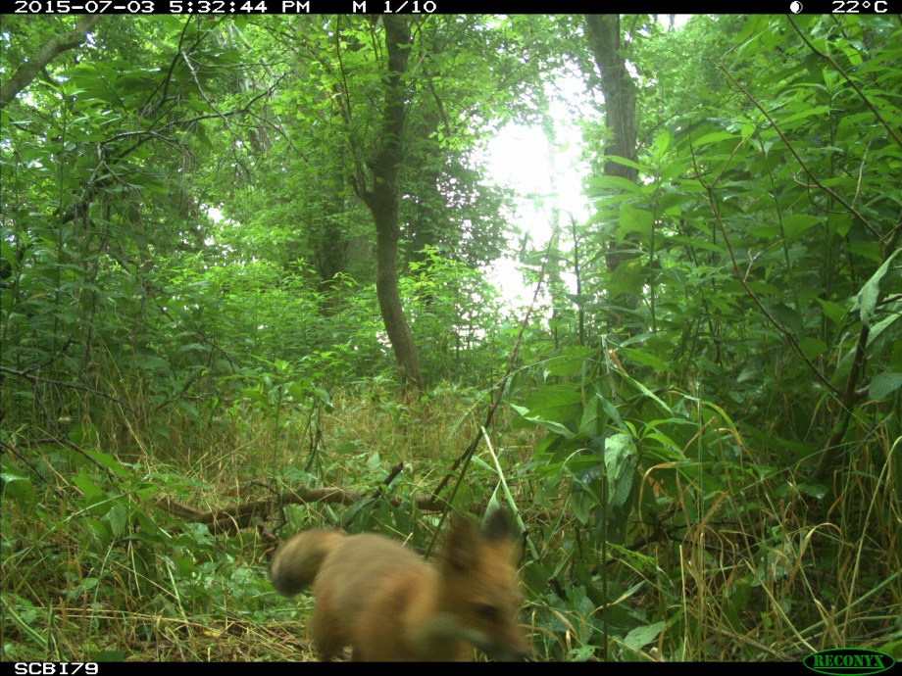
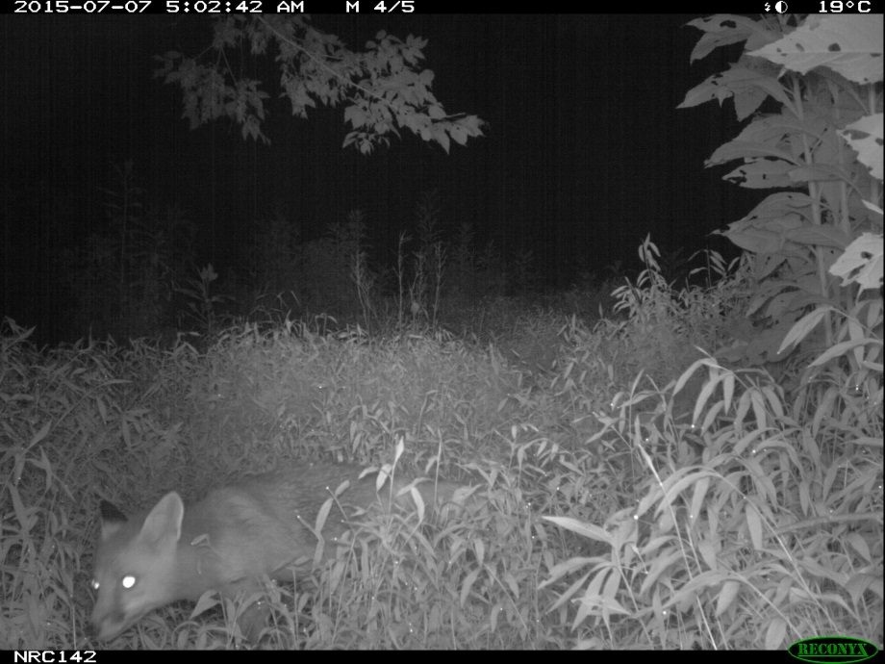
Suburban 3
LESSON 2 - Outfoxed
Notes:
4 red foxes
Top left: Urban to Wild Project
All others: Smithsonian BioAcoustic Monitoring Project

Slide 7
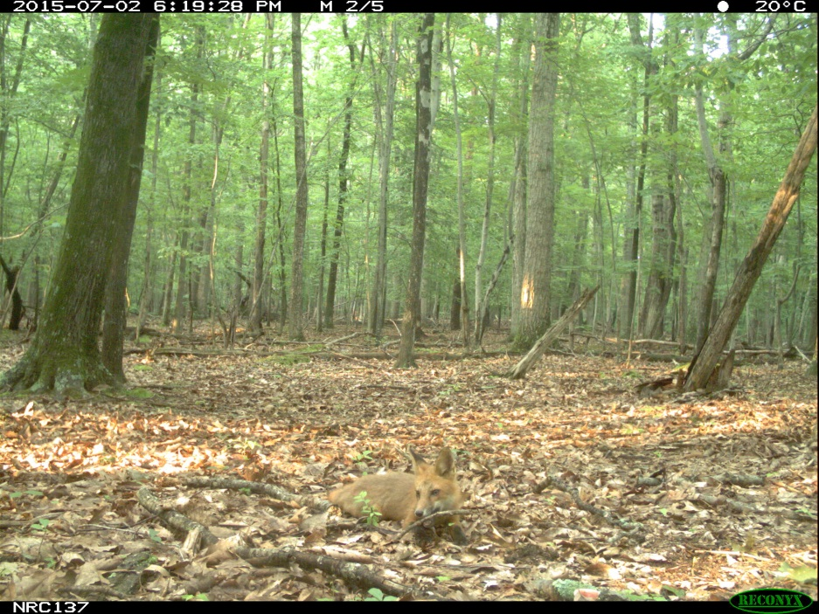
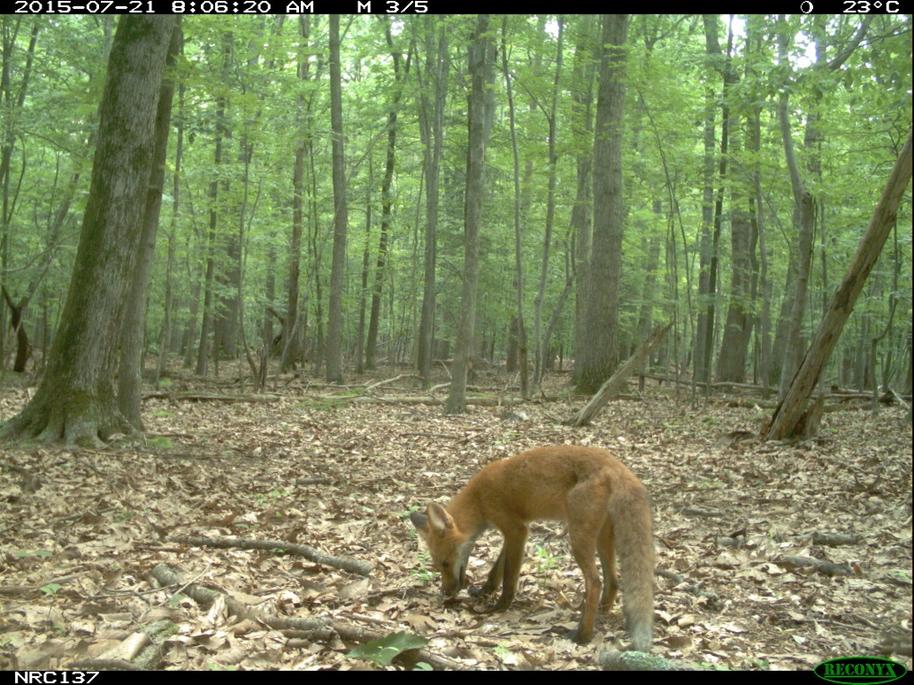
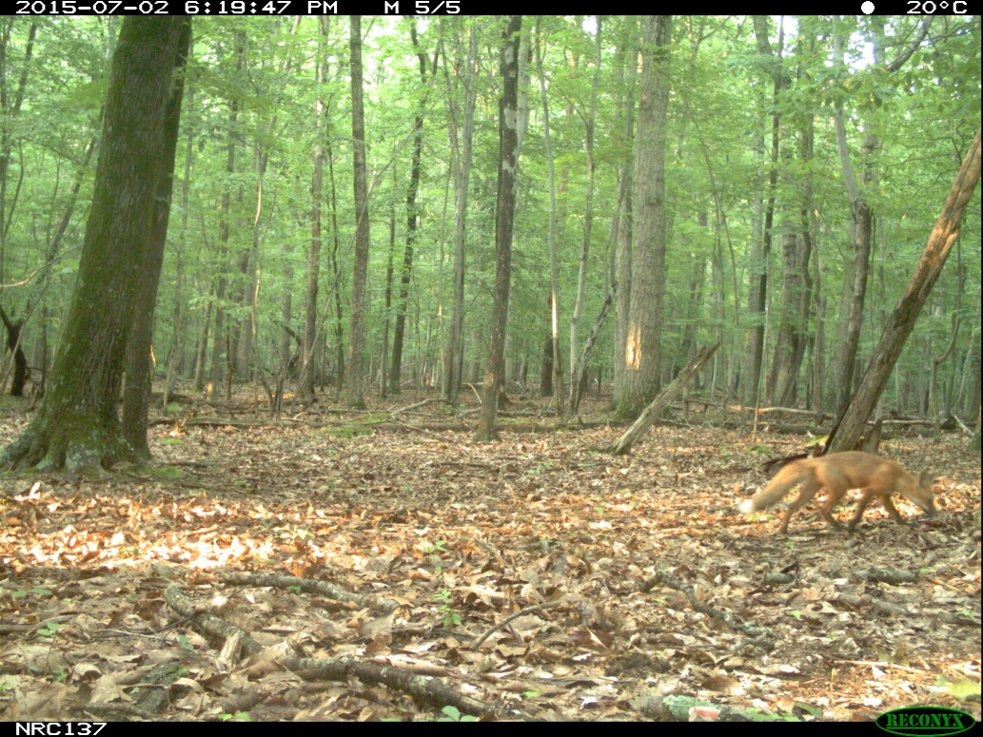
Suburban 4
LESSON 2 - Outfoxed
Notes:
3 red foxes; Smithsonian BioAcoustic Monitoring Project

Slide 8
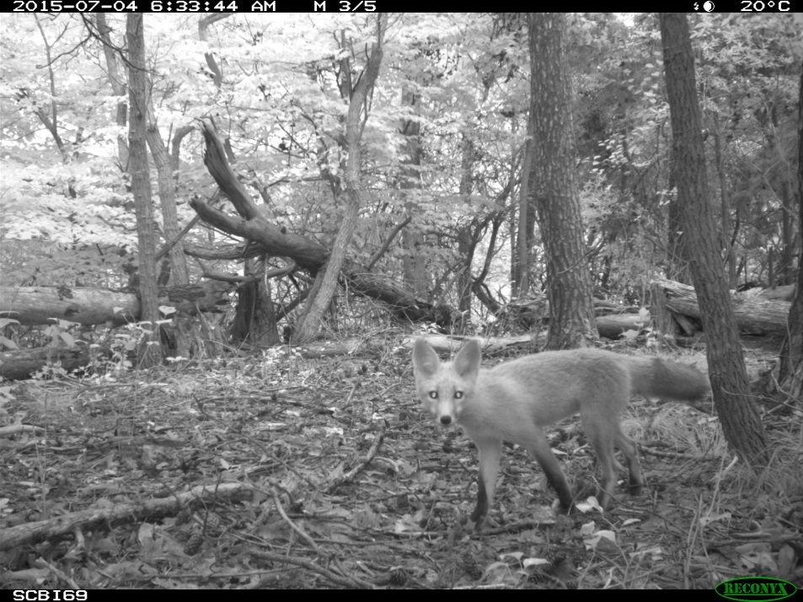
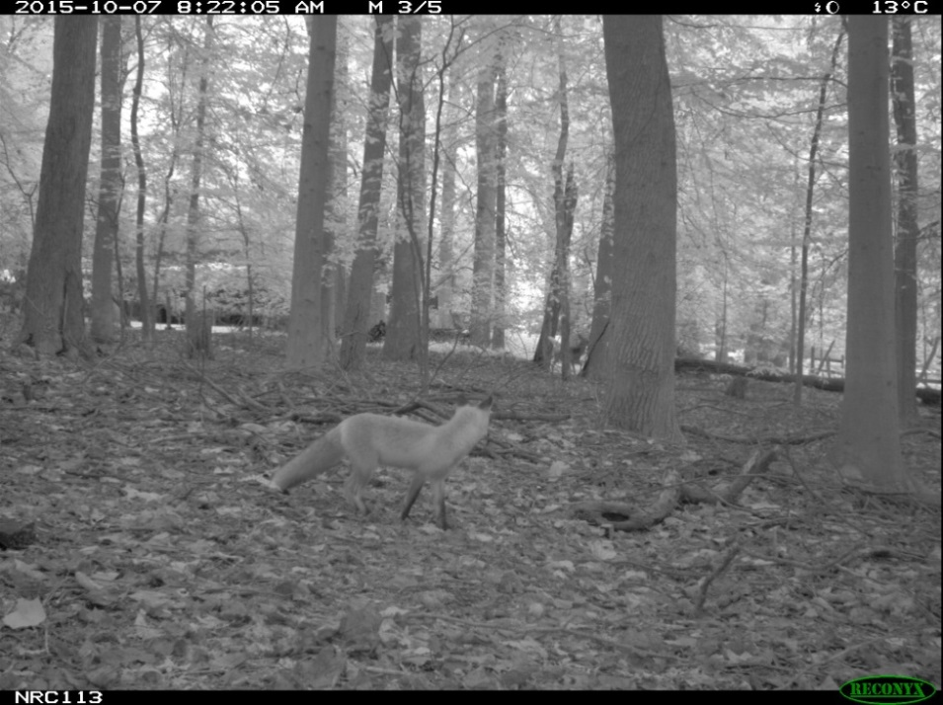
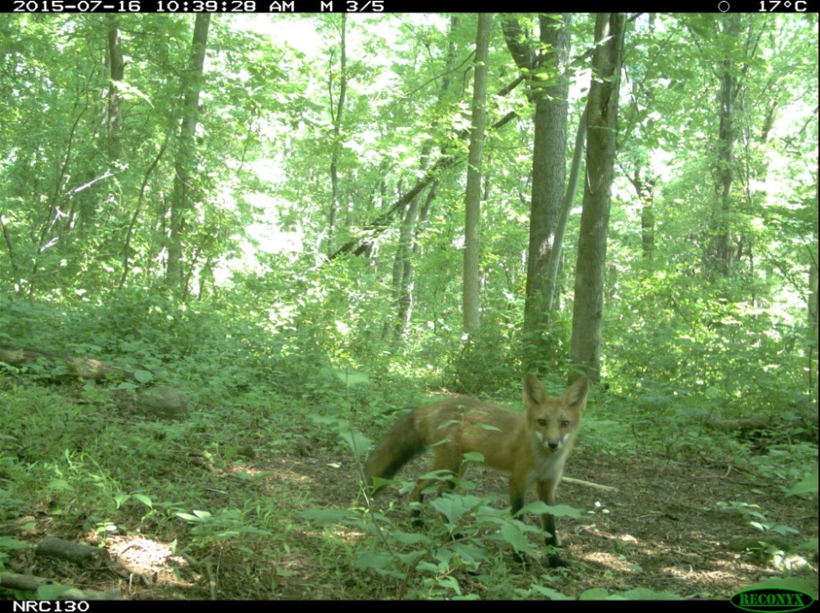
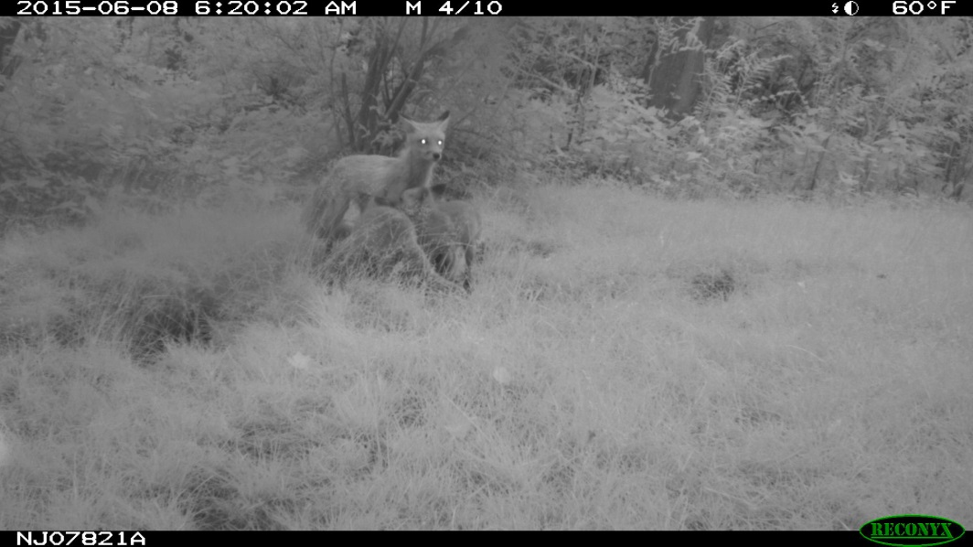
Exurban 1
LESSON 2 - Outfoxed
Notes:
4 red foxes;
Top left: Wildlife in Your Watershed
Top right and bottom left: Urban to Wild
Bottom right: Independent Camera Trap Survey Project

Slide 9
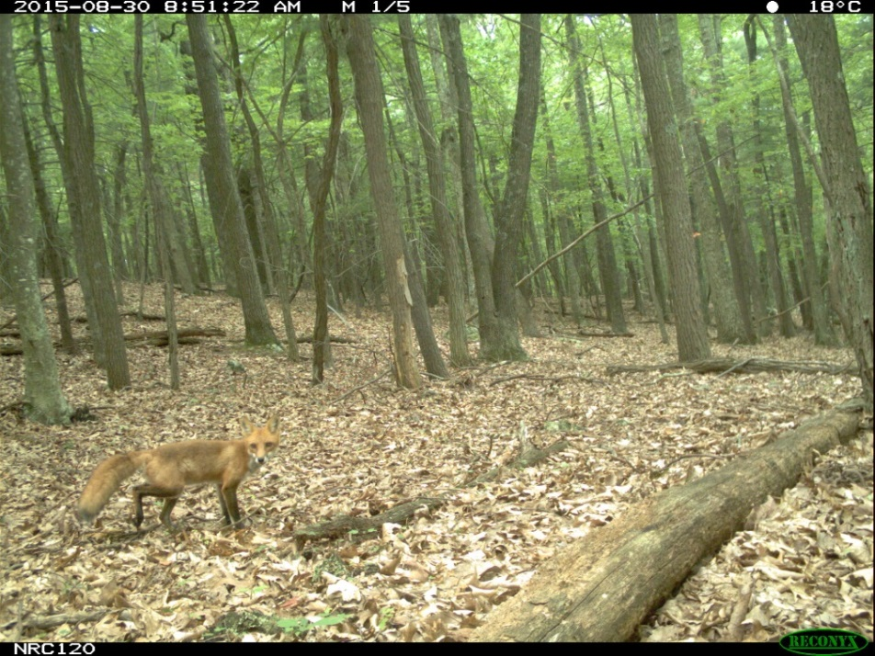
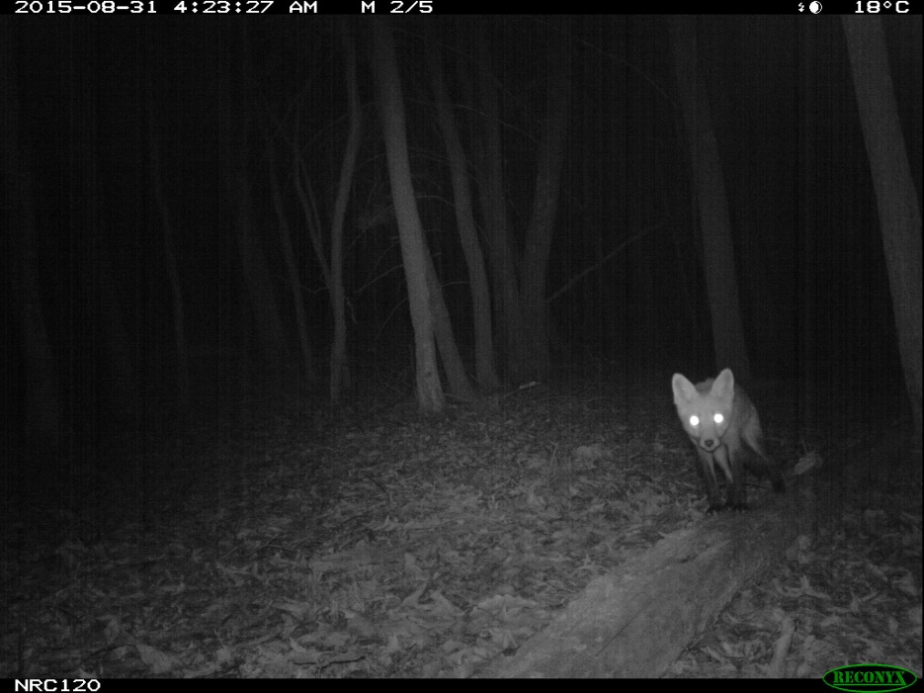
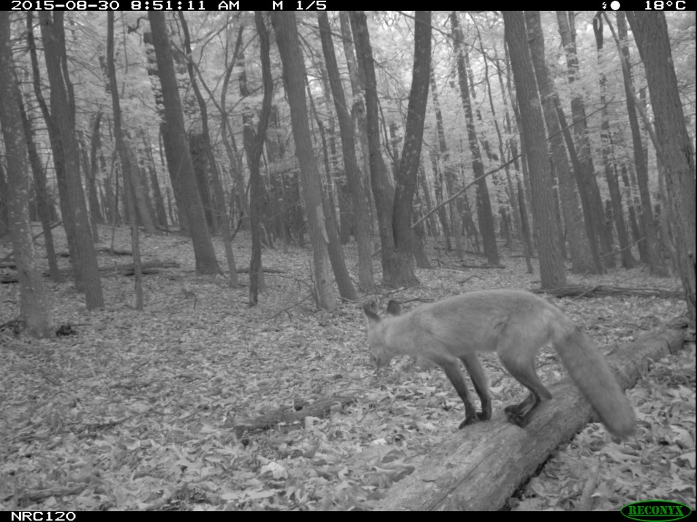
Exurban 2
LESSON 2 - Outfoxed
Notes:
4 red foxes

Slide 10
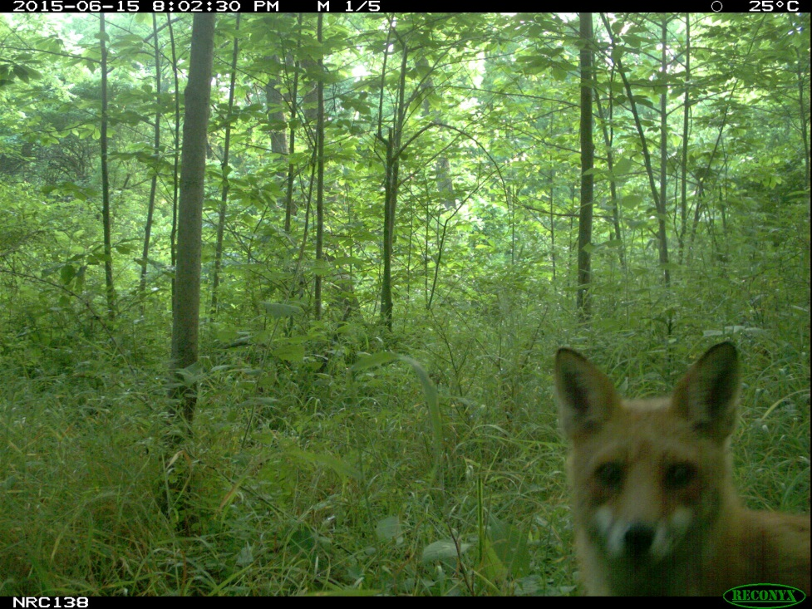
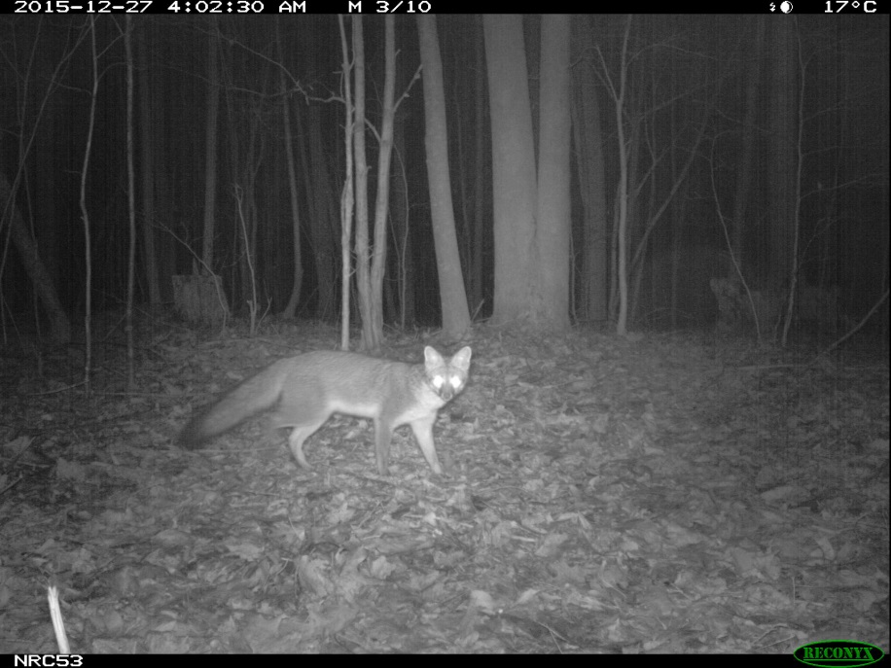
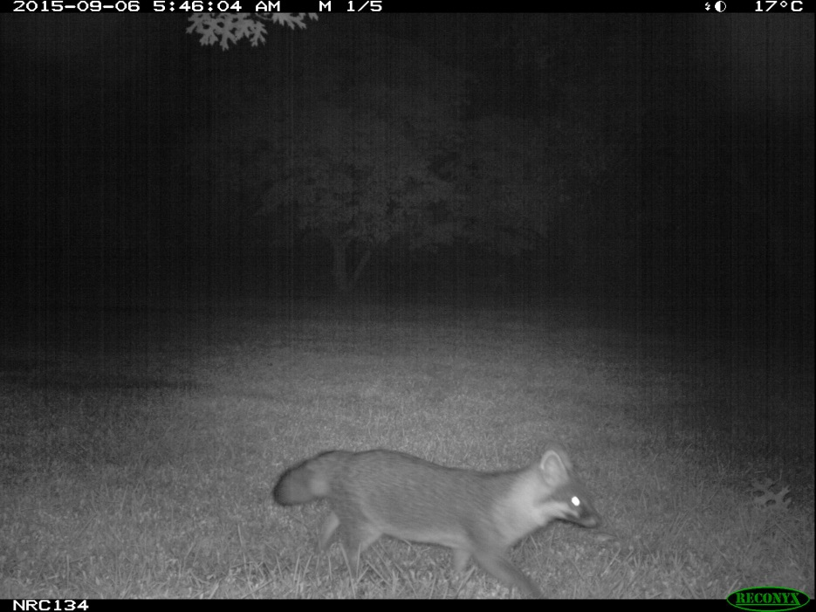
Rural 1
LESSON 2 - Outfoxed
Notes:
2 red (top), 2 gray (bottom)
Bottom left: Triangle Camera Trap Survey Project;
All others: Urban to Wild Project

Slide 11
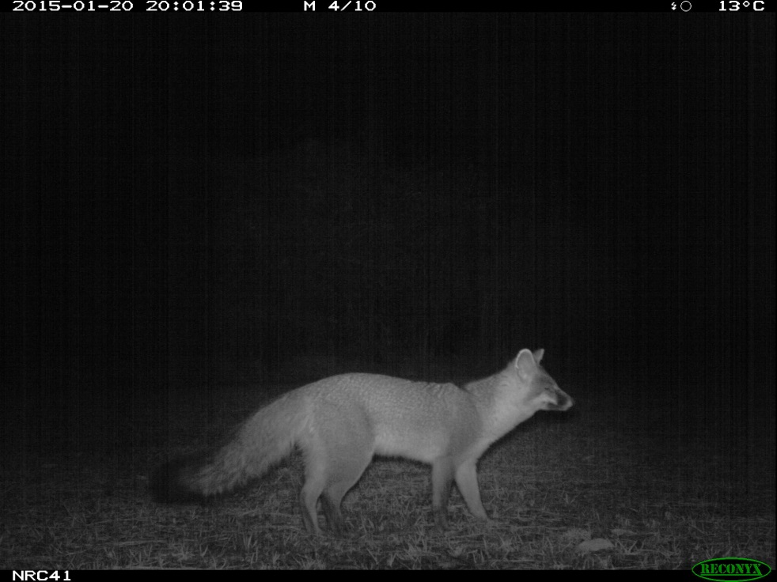
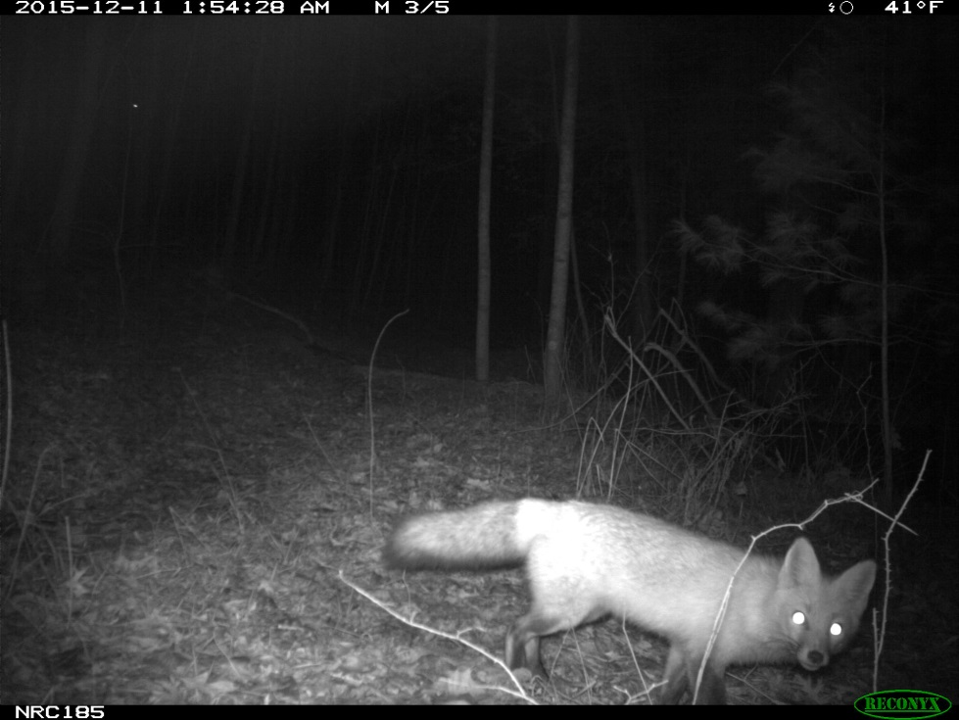
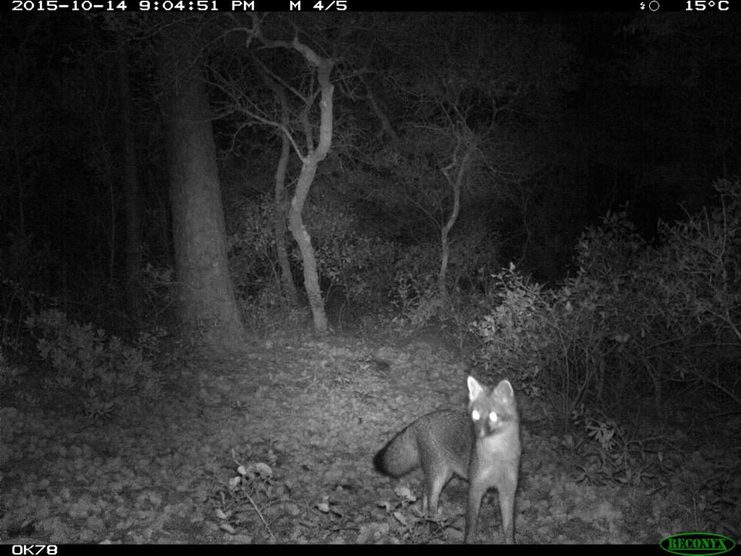
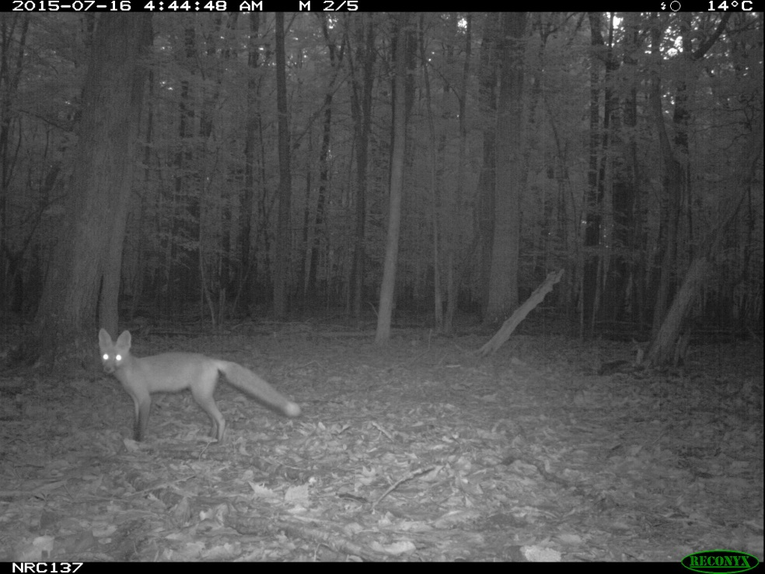
Rural 2
LESSON 2 - Outfoxed
Notes:
2 red foxes (right), 2 gray (left)
Top images: Students Discover North Carolina;
Bottom left: Okaloosa SCIENCE Project;
Top right: Urban to Wild Project
Bottom right: Smithsonian BioAcoustic Monitoring Project

Slide 12
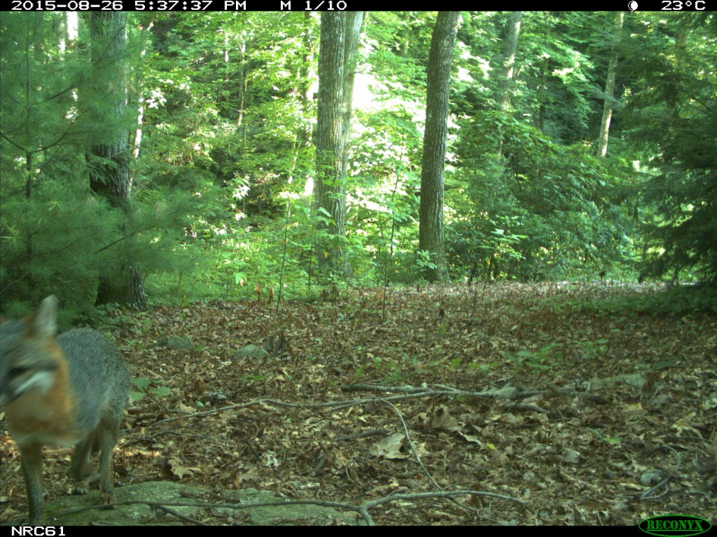
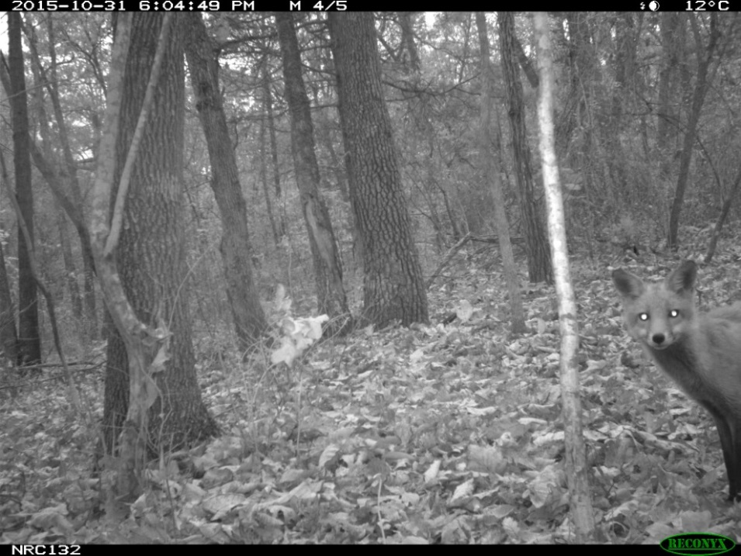
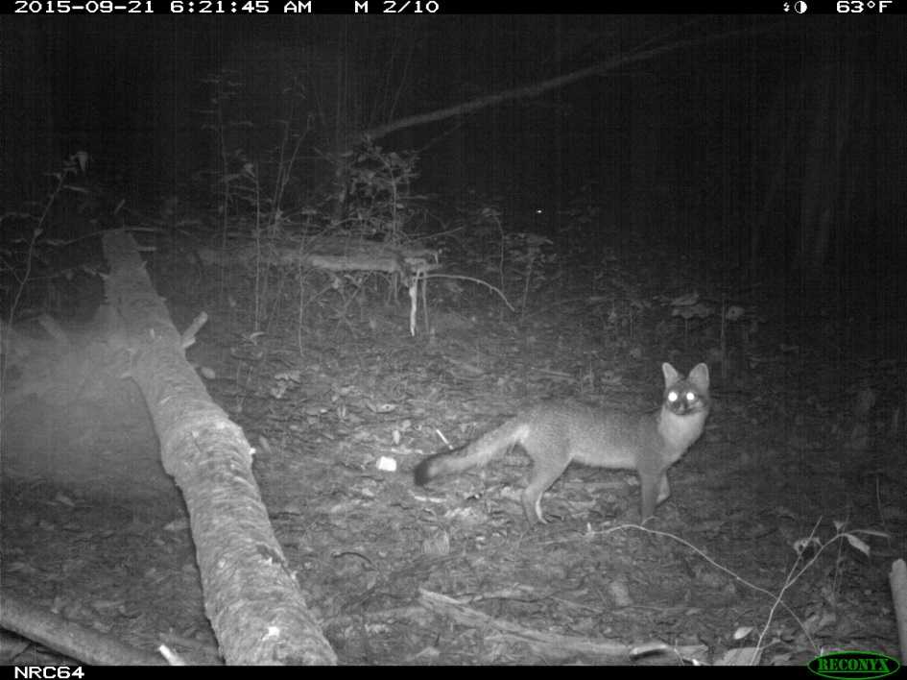
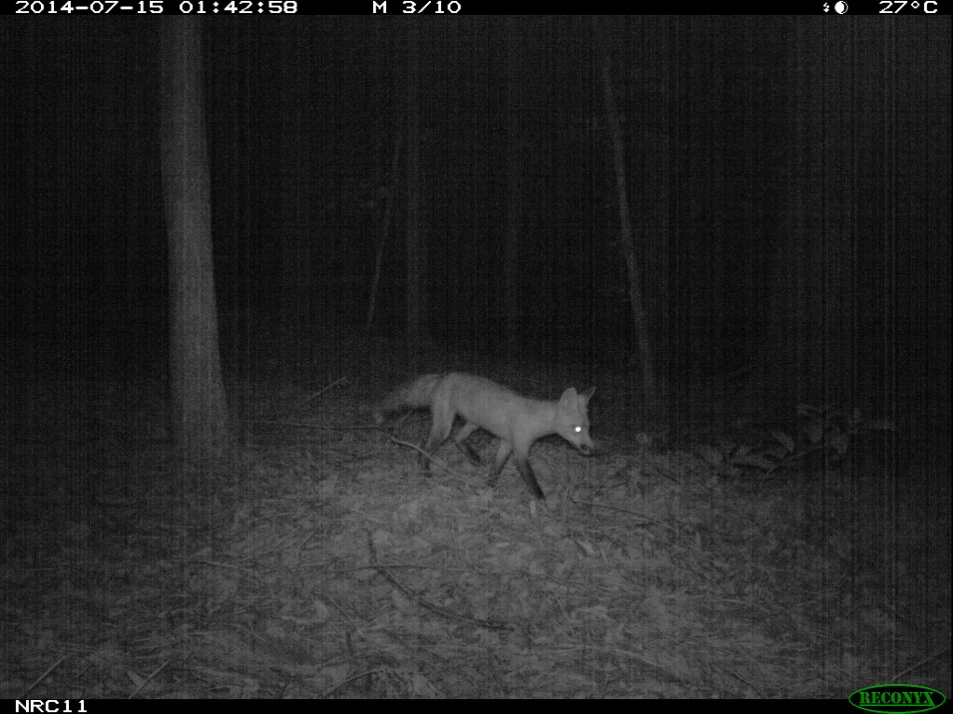
Rural 3
LESSON 2 - Outfoxed
Notes:
2 red foxes (right), 2 gray (left)
Left images: Carl Sandburg Home NHS Project
Top right: Urban to Wild Project
Bottom right: Triangle Camera Trap Survey Project

Slide 13
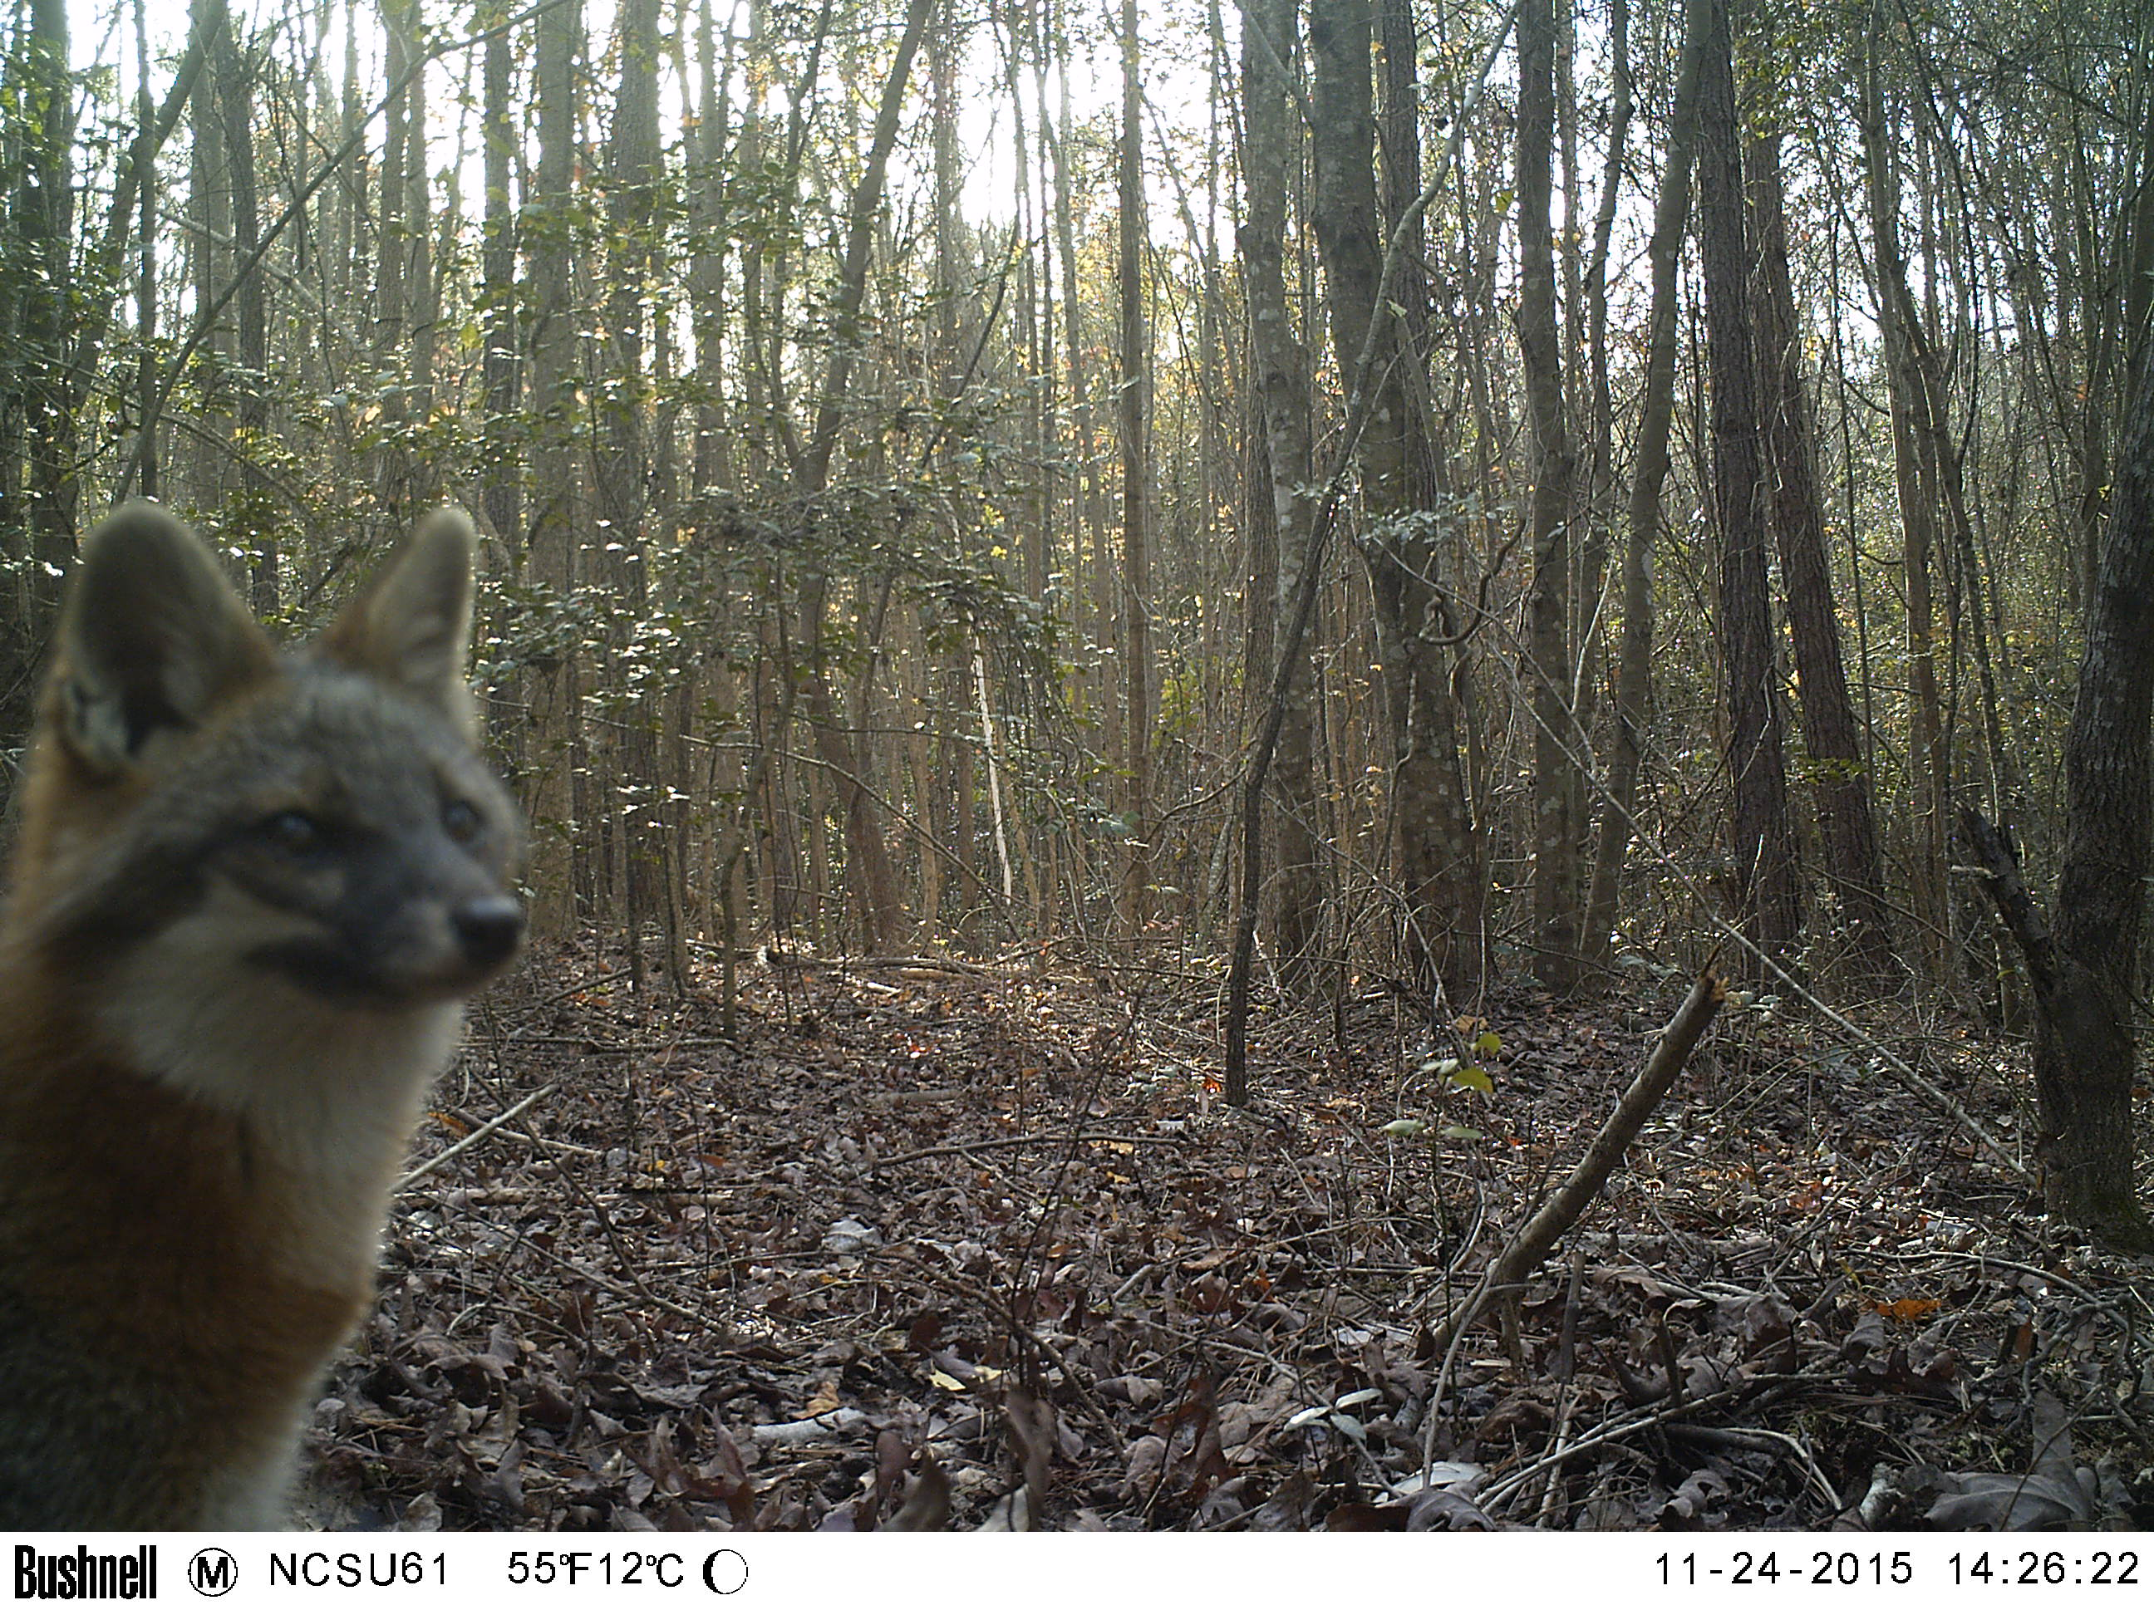
Wild
LESSON 2 - Outfoxed
Notes:
1 gray

