Slide 1
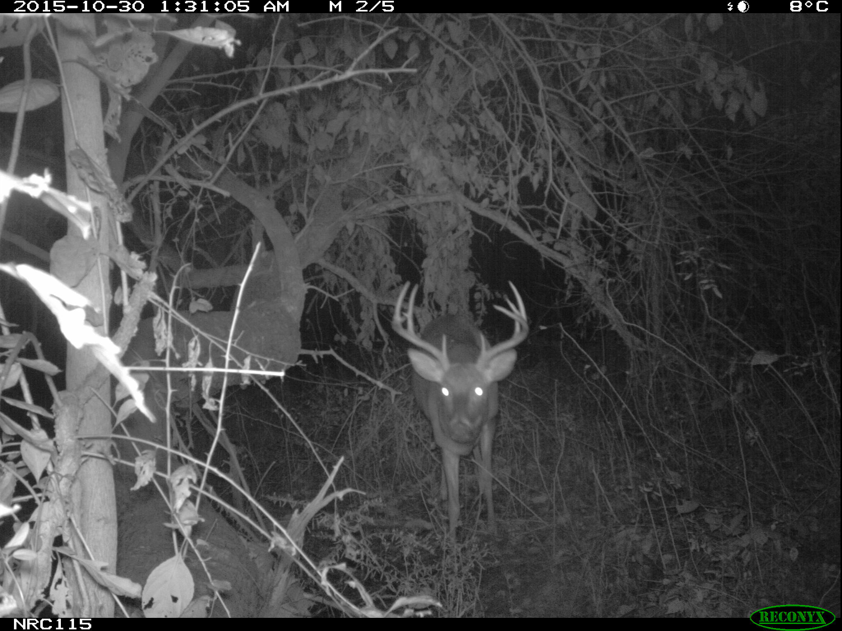
Notes:
STEP 2.2 – Practice Image 1 of 4
Urban to Wild Project, Virginia, white-tailed deer (Odocoileus virginianus)

Slide 2
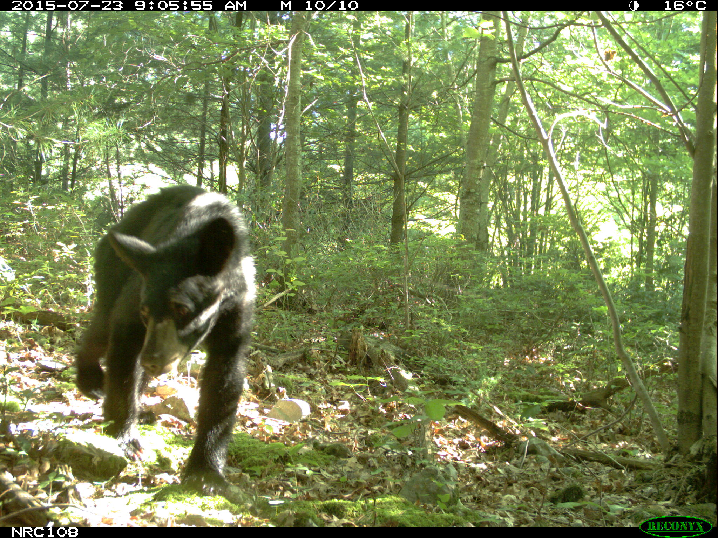
Notes:
STEP 2.2 – Practice Image 2 of 4
Urban to Wild Project, Virginia, black bear (Ursus americanus)

Slide 3
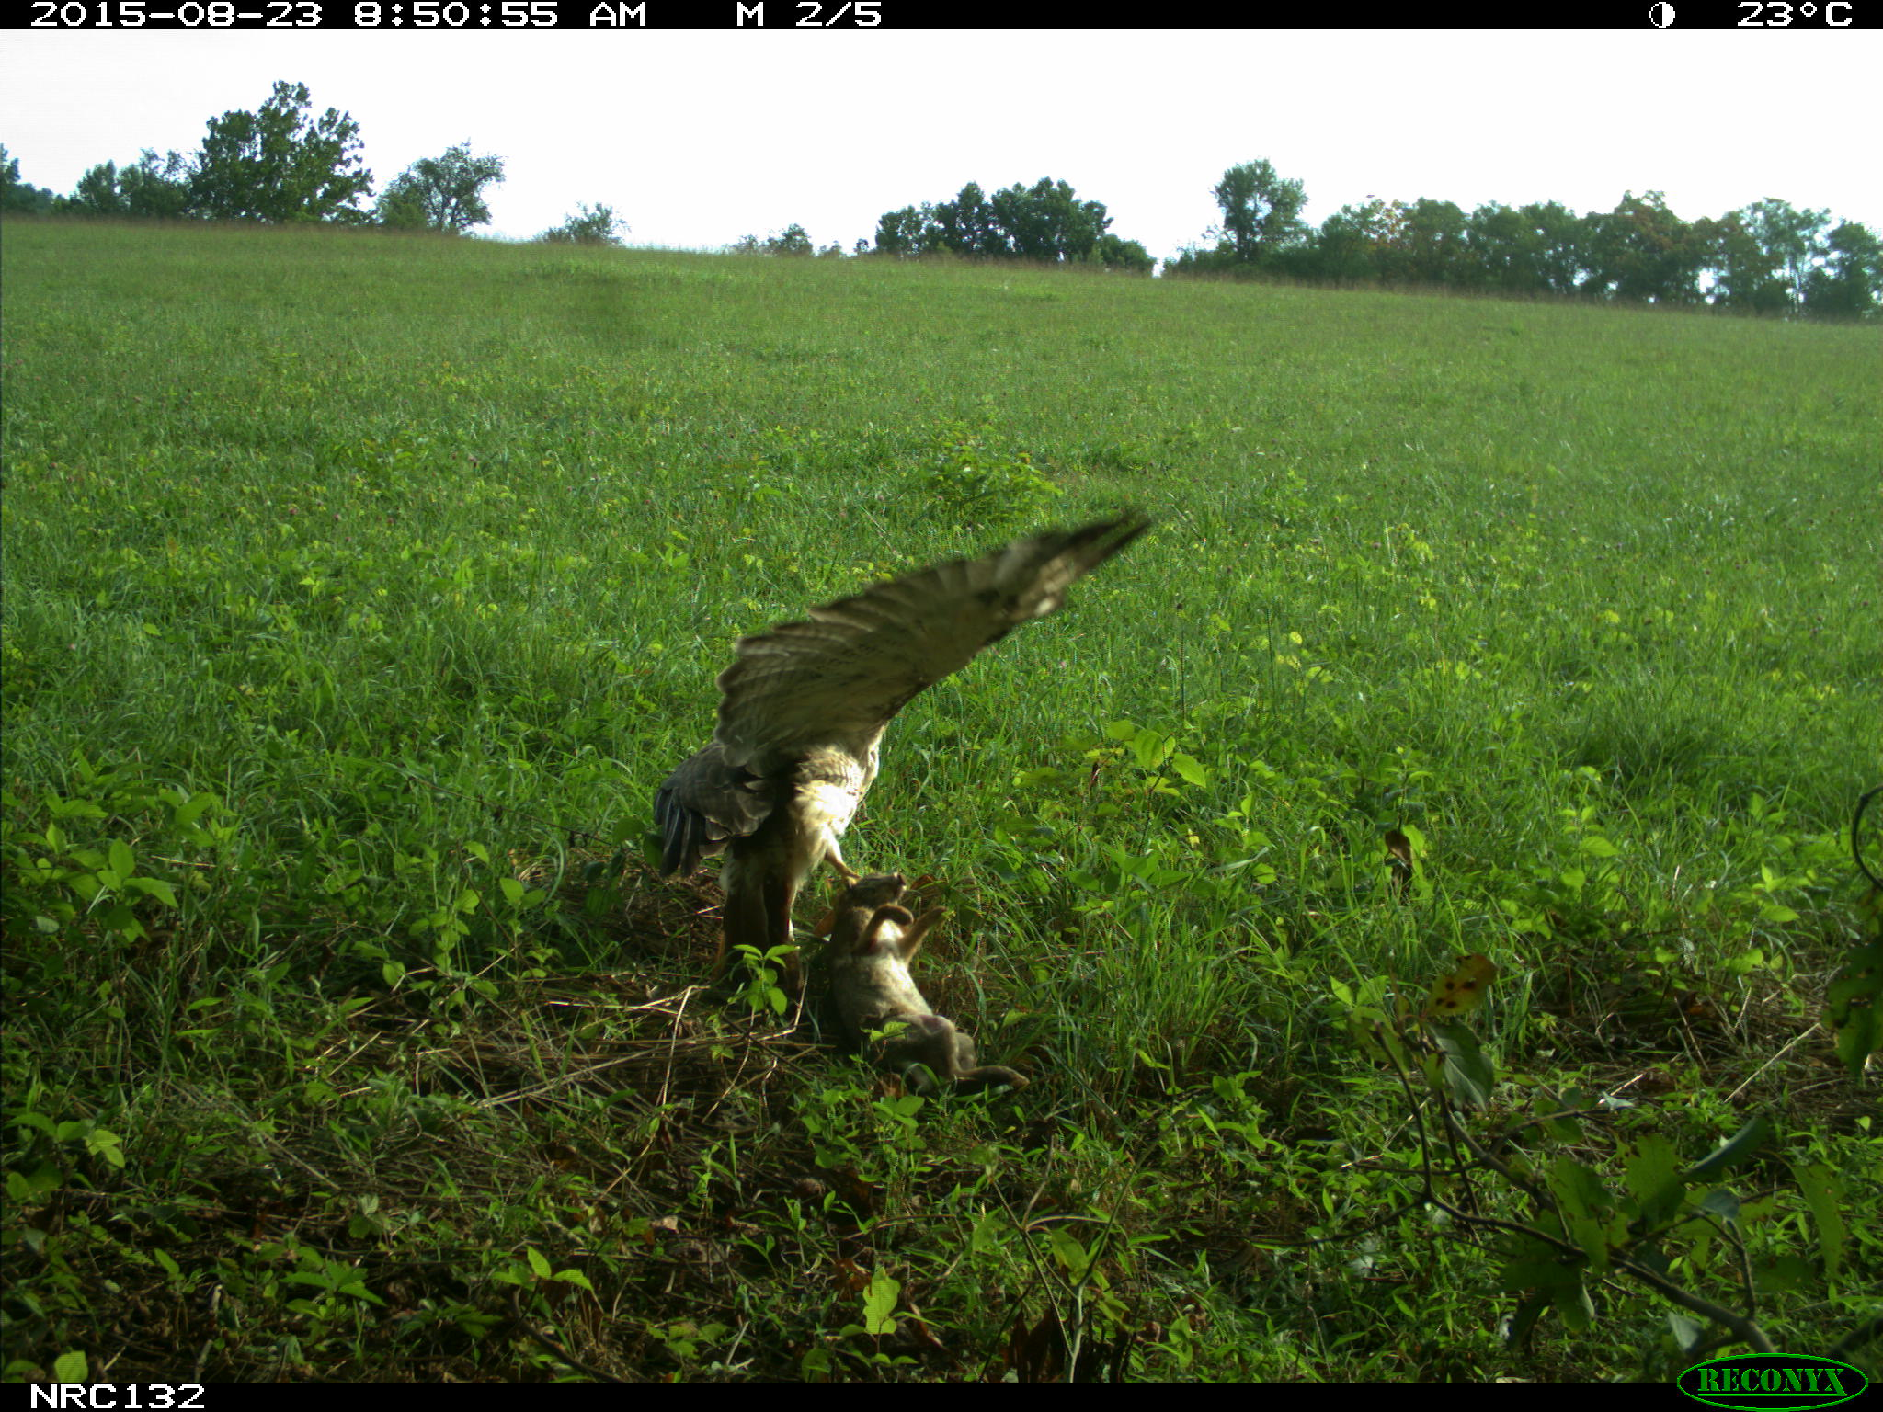
Notes:
STEP 2.2 – Practice Image 3 of 4
Urban to Wild Project, Virginia, raptor and rabbit species

Slide 4
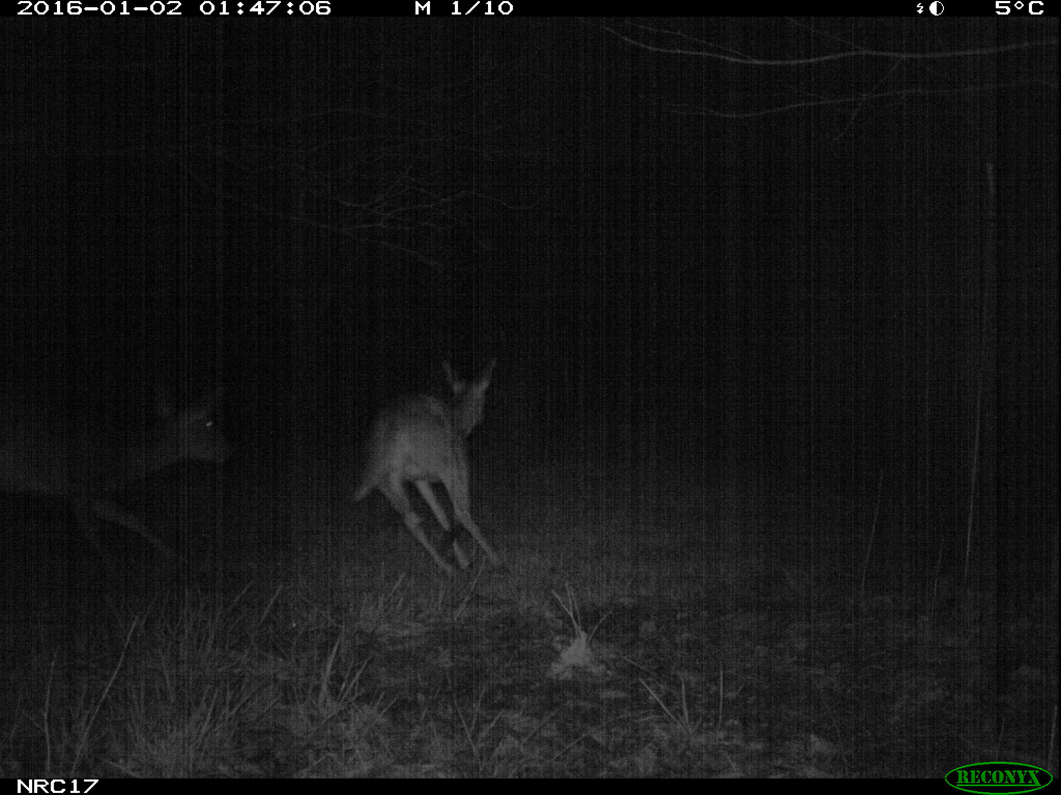
Notes:
STEP 2.2 – Practice Image 4 of 4
Prairie Ridge Project, white-tailed deer (Odocoileus virginianus)

Slide 5
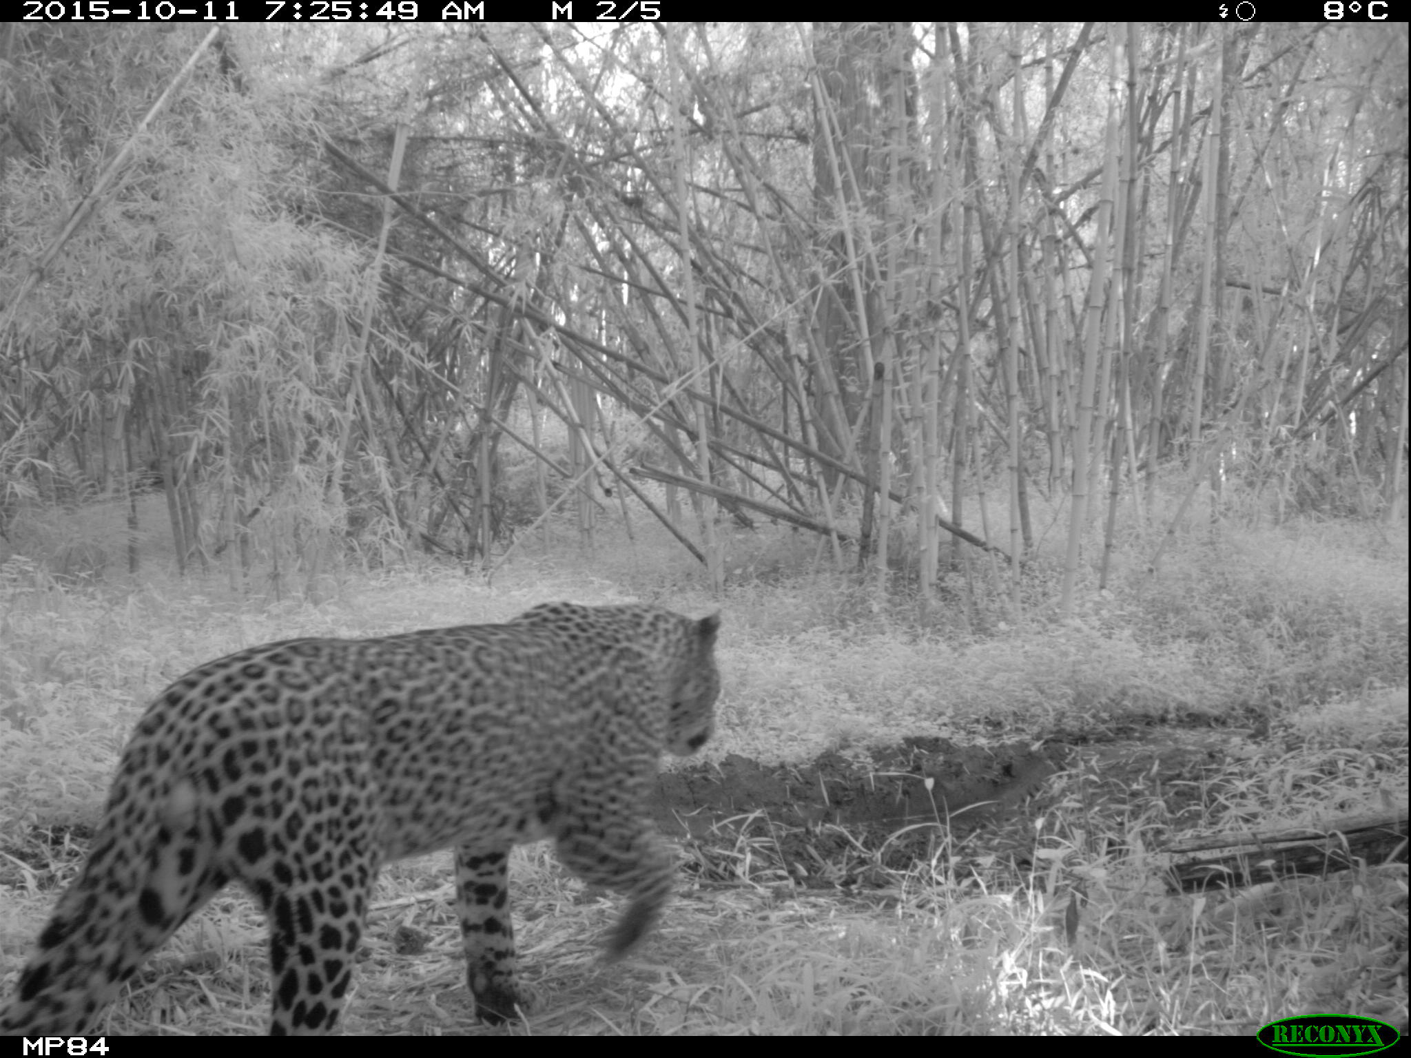
Notes:
STEP 2.6 – Individual animals can be identified based on spot/stripe patterns or other unique features
Example: Leopard (Panthera pardus) from the Mount Kenya Survey

Slide 6
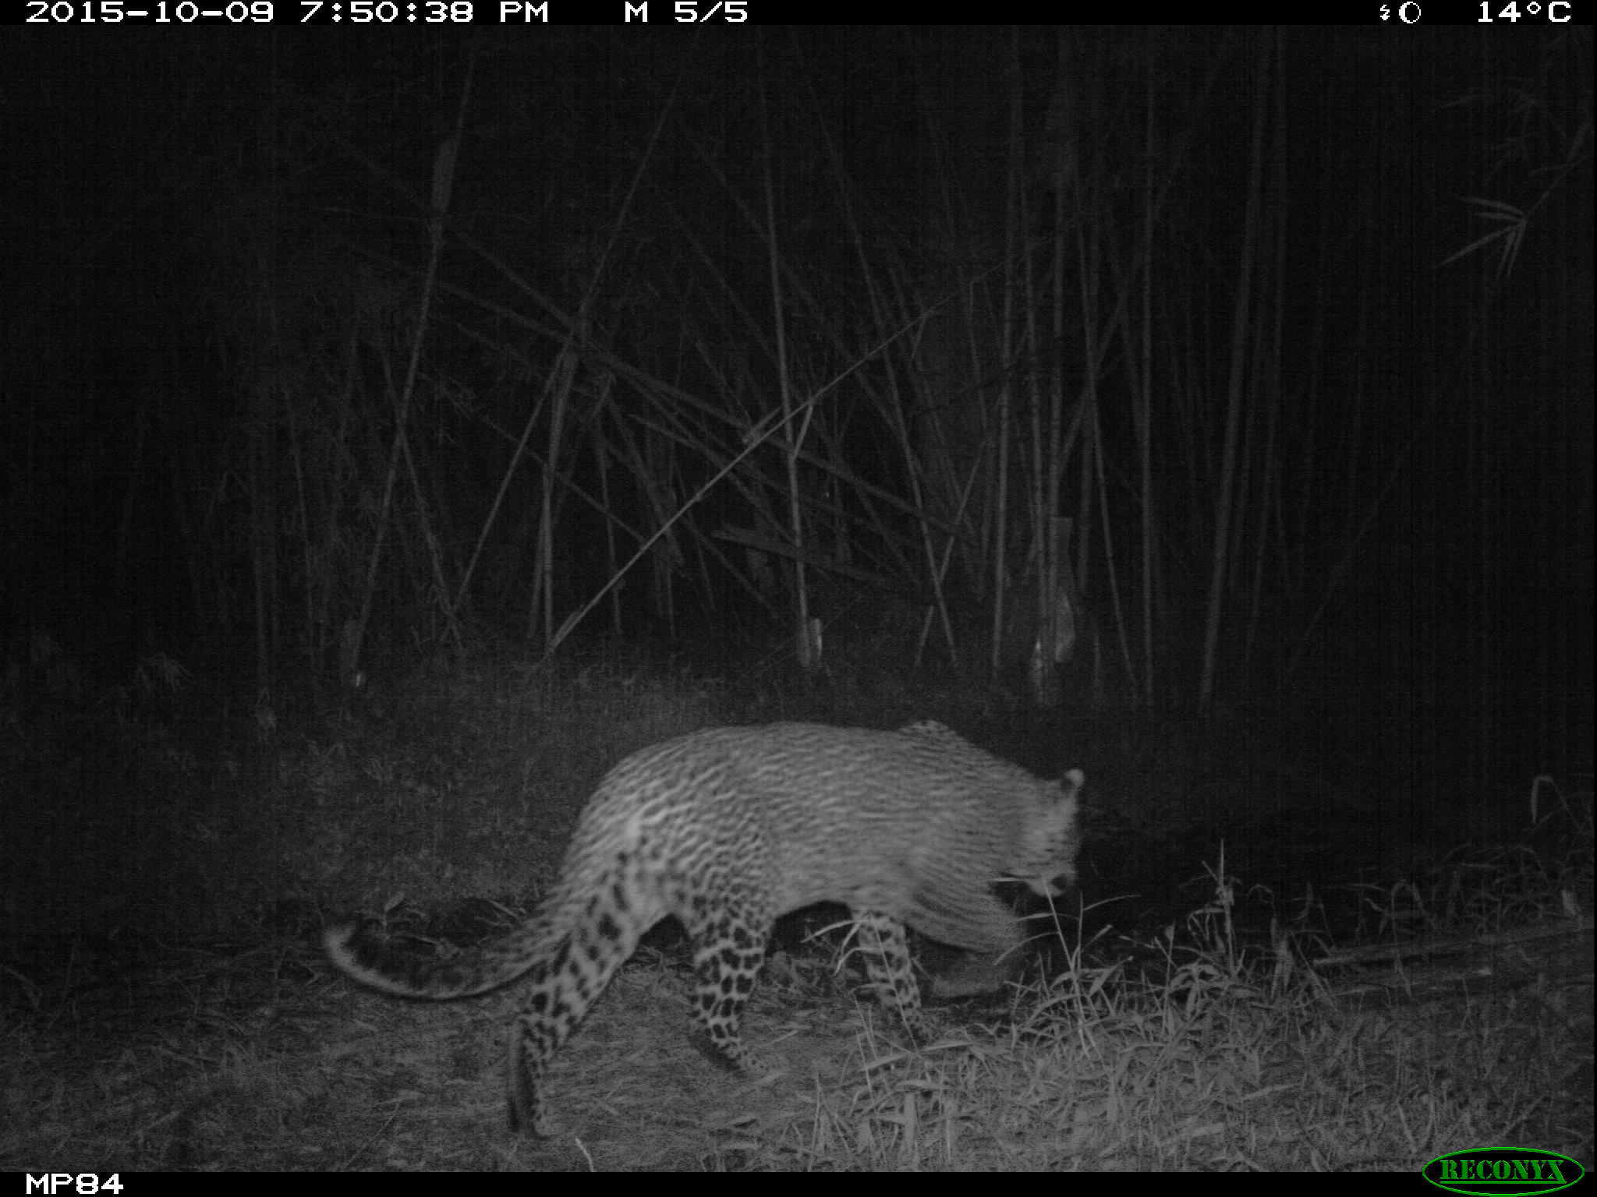
Notes:
STEP 2.6 – Individual animals can be identified based on spot/stripe patterns or other unique features
Example: Leopard (Panthera pardus) from the Mount Kenya Survey

Slide 7
Leopard 1 Leopard 2
Notes:
STEP 2.6 – Individual animals can be identified based on spot/stripe patterns or other unique features
Example: Leopards (Panthera pardus) from the Mount Kenya Survey

