Slide 1
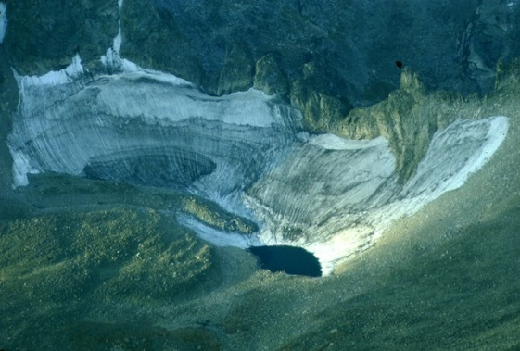
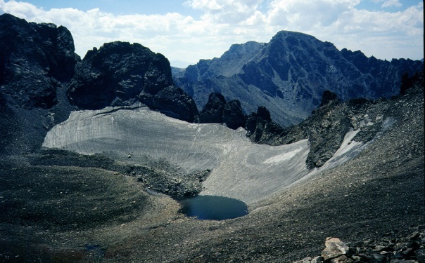
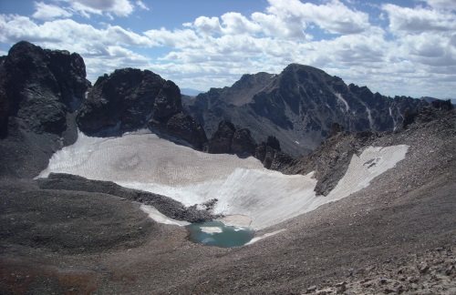
Name:_____________
ScienceLIVE
Glacier Mass Balance Worksheet
Background Information: Glaciers are always changing. They move downhill, but also change in size. Glaciers get larger when they accumulate more mass through heavy snowfall, and get smaller when they lose mass due to ablation. At Niwot Ridge Long Term Ecological Research site in the Front Range of Colorado, there is a small glacier, Arikaree, that scientist Nel Caine has monitored for more than forty years! While it is near impossible to measure the actual mass of the ice at Arikaree glacier, Nel is able to measure the accumulation and ablation each year. With that data he is able to calculate a mass balance, that tells us whether the mass of the glacier is increasing or decreasing. Using Nel’s data here, see if you can come up with your own conclusion of what is happening to Arikaree glacier.
Scientific Question: Is the mass of Arikaree glacier increasing or decreasing?
Look at the pictures of Arikaree glacier below. What do you observe?
1981 2002 2010
What is your prediction? Is the mass of Arikaree glacier increasing or decreasing?
What observations of the photos above support your prediction?

Slide 2
ScienceLIVE
Data: The data for annual mass accumulation and ablation are in a table below. Units are in cm. WE, which is centimeters of water equivalency. Using this data, calculate the mass balance. Next, calculate the cumulative mass balance by adding the mass balance from the previous year to the current year. The first few rows are done as an example.
Mass Balance Calculation = Annual Accumulation – Annual Ablation
Year | Annual Accumulation (cm WE) | Annual Ablation (cm WE) | Annual Mass Balance (cm WE) | Cumulative Mass Balance (cm WE)
2000 | 292.0 | 356.0 | 356.0-292.0 = -64.0 | -64.0
2001 | 189.8 | 386.3 | 386.3-189.8= -196.5 | -64.0 + -196.5 = -260.5
2002 | 173.9 | 471.3
2003 | 251.8 | 349.5
2004 | 243.7 | 280.3
2005 | 236.2 | 363.3
2006 | 198.5 | 388.5
2007 | 188.4 | 419.9
2008 | 306.5 | 308.8
2009 | 327.4 | 302.4
2010 | 359.4 | 376.7
2011 | 327.3 | 312.7
2012 | 205.7 | 404.1
2013 | 200.2 | 353.3
Using the cumulative mass balances you calculated above, graph the cumulative mass balance below.

Slide 3
ScienceLIVE
Claim: Using the information from your graph, write a statement that answers the scientific question: “Is the mass of Arikaree glacier increasing or decreasing?”
Evidence: What data from the table or graph supports your claim above? Refer to the graph or table to explain your reasoning.
Connections: Why do you think Arikaree glacier is losing/gaining mass? Can you think of an explanation? Brainstorm some ideas and write them below.
Note: Data courtesy of Thomas Nelson Caine, Niwot Ridge LTER, 2013.

