Slide 1
Glaciers on the Move
Katya Hafich
Biological Science Initiative Science Squad 2012
University of Colorado at Boulder

Slide 2
What is a glacier?
A glacier is a large mass of ice that moves very slowly.

Slide 3
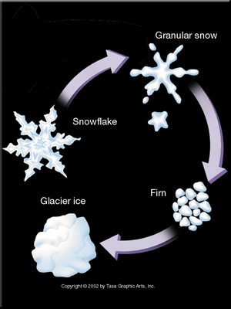
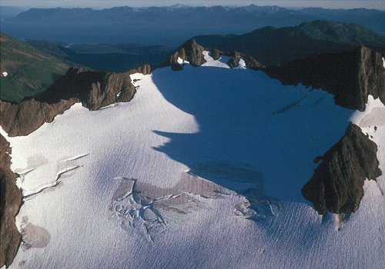
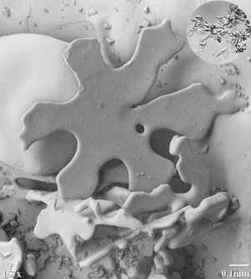
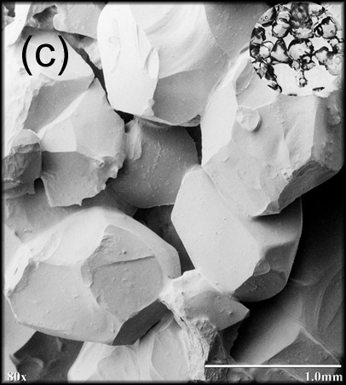
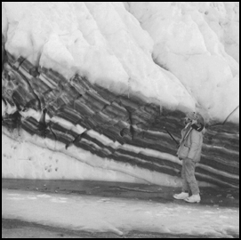
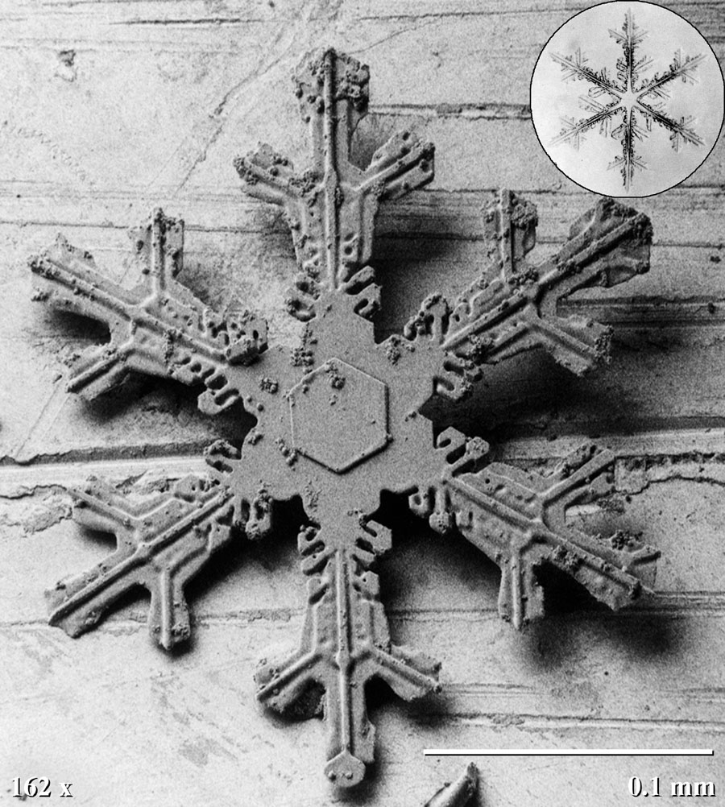
How do glaciers form?
http://www.asf.alaska.edu/program/sdc/project/glacier_power/how_glaciers_form#
http://ceramics.org/ceramictechtoday/tag/scanning-electron-microscope-snowflakes/
http://ceramics.org/ceramictechtoday/tag/scanning-electron-microscope-snowflakes/
://geology.about.com/od/glaciers_ice/ig/glacier-pictures/cirque-glacier.htm
http://www.enm.bris.ac.uk/teaching/projects/2002_03/jb8355/sphere_packing.html
Glaciers are created when snow accumulates year after year and does not melt.
http://imnh.isu.edu/Exhibits/Online/RLO/GeoOutreach/index.php?r=rockexternal&s=causes
Notes:
Small glaciers might move 10 feet a year, large glaciers can move as much as half a mile or more

Slide 4
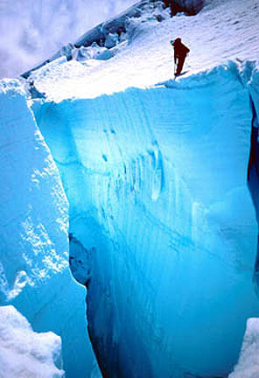
Anatomy of a Glacier
http://www.crevasse.com/images/Gallery02/003.html
http://imnh.isu.edu/Exhibits/Online/RLO/GeoOutreach/index.php?r=rockexternal&s=anatomy
Notes:
Glacial erosion can also create spectacular peaks like the Matterhorn in Switzerland.

Slide 5
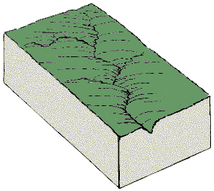
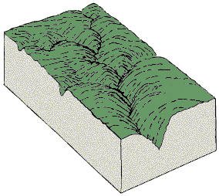
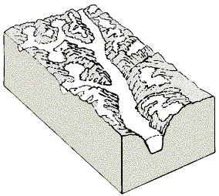
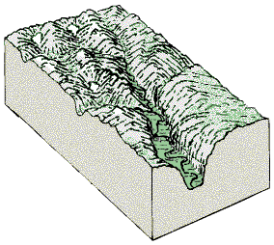
Glaciers change the landscape…
http://www2.nature.nps.gov/geology/usgsnps/glacier/uvalley.html
http://www.coolgeography.co.uk/GCSE/Year%2010/PhysicalWorld/Glacial%20Landforms/glacial_landforms.htm
Notes:
U-shaped valleys are formed by glacial movement.

Slide 6
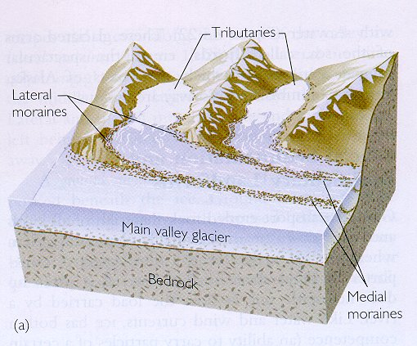
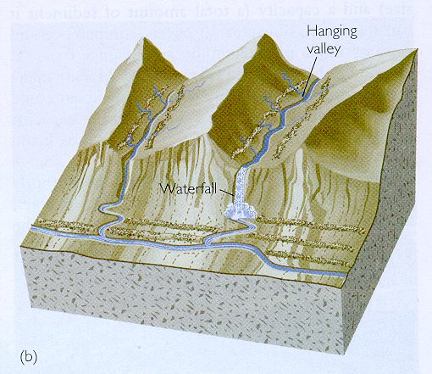
Glaciers change the landscape…
Hanging valleys
http://www.coolgeography.co.uk/GCSE/Year%2010/PhysicalWorld/Glacial%20Landforms/glacial_landforms.htm
http://www.cygnusx1.ca/uploaded_images/milford-sound-702224.jpg
Notes:
These striations are left from a glacier moving past a rock wall in Alaska-the Yale Glacier.

Slide 7
Glaciers change the landscape as they move…
Glacial troughs
http://nsidc.org/cryosphere/glaciers/gallery/troughs.html
Notes:
This is western Brook glacial trough in Newfoundland, Canada. Before a glacier formed in the area, this gorge was a normal river valley near sea level. As the plateau was altered during the Ice Age, powerful outlet glaciers deepened and widerned the valley.

Slide 8
Glaciers change the landscape as they move…
Arête
http://www.backpacker.com/august_08_phenomenon_glacial_relics/nature/12484?page=2
Notes:
Aretes are knife-edged ridges formed when two adjacent glaciers carve parallel U-shaped valleys until only a long, narrow crest remains in between. Arete is french for fish bone. This arete is in Glacier National Park.

Slide 9
Glaciers change the landscape as they move…
Horn
http://www.backpacker.com/august_08_phenomenon_glacial_relics/nature/12484?page=2
Notes:
Aretes are knife-edged ridges formed when two adjacent glaciers carve parallel U-shaped valleys until only a long, narrow crest remains in between. Arete is french for fish bone. This arete is in Glacier National Park.

Slide 10
Glaciers change the landscape as they move…
Striations
http://nsidc.org/cryosphere/glaciers/gallery/grooves.html
Notes:
These striations are left from a glacier moving past a rock wall in Alaska-the Yale Glacier.

Slide 11
Glaciers change the landscape as they move…
Polish
http://faculty.gg.uwyo.edu/neil/glaciology/photos/glacial_polish.JPG
Notes:
These striations are left from a glacier moving past a rock wall in Alaska-the Yale Glacier.

Slide 12
Glaciers change the landscape as they move…
Erratic
http://travellogs.us/2007Logs/Alberta%202007/119-Buffalo%20Jump/119-Buffalo%20Jump.htm
Notes:
Glacial erratics are huge boulders left behind by glaciers.

Slide 13
Glaciers change the landscape as they move…
Moraine
http://nsidc.org/cryosphere/glaciers/gallery/moraines.html
Notes:
Moraines are large piles of rocks left by glaciers as they recede. This is a valley glacier on Bylot Island, Canada.

Slide 14
Glacier movement changes the landscape, but the landscape can affect the movement of the glacier.
Different glaciers have different velocities.
http://nsidc.org/cryosphere/glaciers/gallery/terminus.html
Notes:
This is a pair of outlet glaciers at the Royal Society Fjord on the Northeast Baffin Island in Canada. The originate at the same ice cap, but flow at different rates. The tidewater glacier on the left is flowing faster, causing heavy crevassing on its surface.

Slide 15
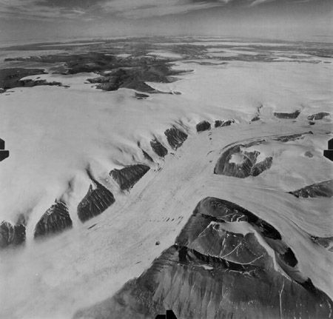
What affects glacier speed?
http://nsidc.org/cryosphere/glaciers/gallery/
Slope
Notes:
On the left is a glacier in Jasper National Park, Canada. On the right is the Kalstenius Icefield on Ellesmere Island, Canada. The glacier is 3 miles wide.

Slide 16
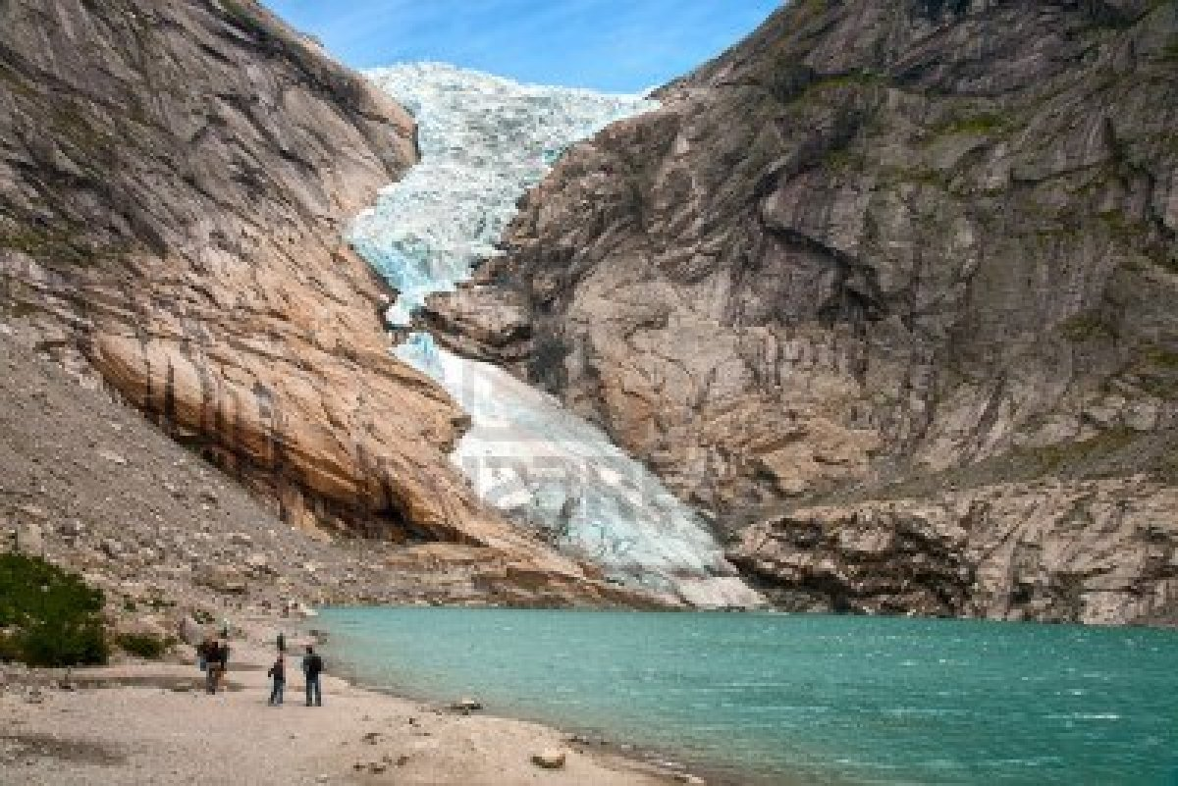
What affects glacier speed?
Ground Surface
Notes:
On the right is the Pitztaler Glacier, Swiss Germany?

Slide 17
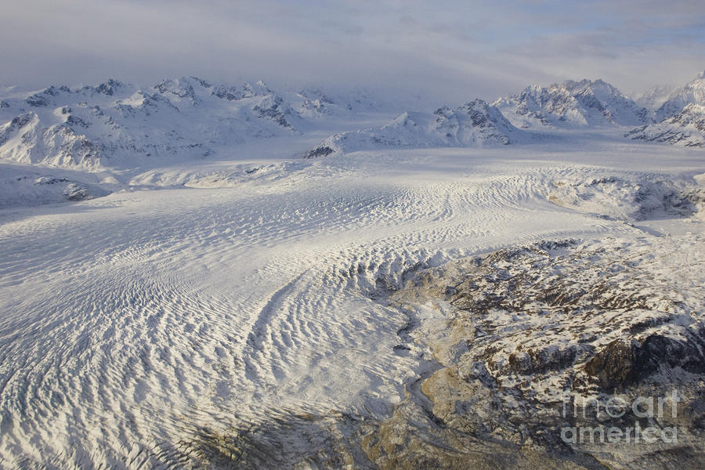
What affects glacier speed?
http://www.rifflsee.at/en/package-details-hotel-rifflsee-pitztal-tyrol/items/glacier-summer.html/
Temperature
http://fineartamerica.com/featured/triumvirate-glacier-in-winter-light-tim-grams.html/
Notes:
On the right is the Pitztaler Glacier, Swiss Germany?

Slide 18
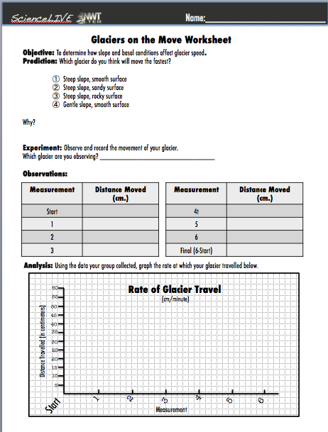
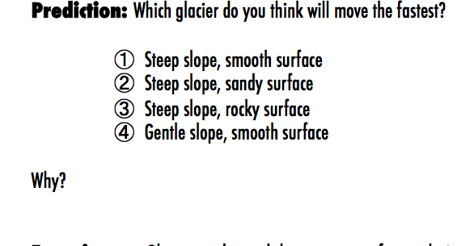
Test it for yourself…

Slide 19
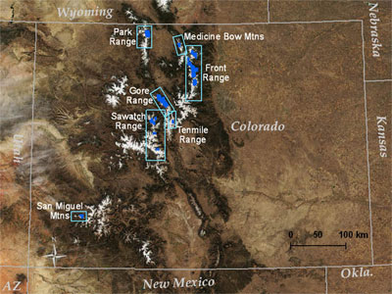
We have glaciers here in Colorado!
http://glaciers.research.pdx.edu/glaciers-colorado
Notes:
Colorado has 14 named glaciers, all in the Front Range. Most glaciers and snowfields in Colorado occur in east to north-facing cirques at high elevations near the ridge crests. These locations favor snow accumuliation from avalanches and windblown snow in winter, well-shaded from sun

Slide 20
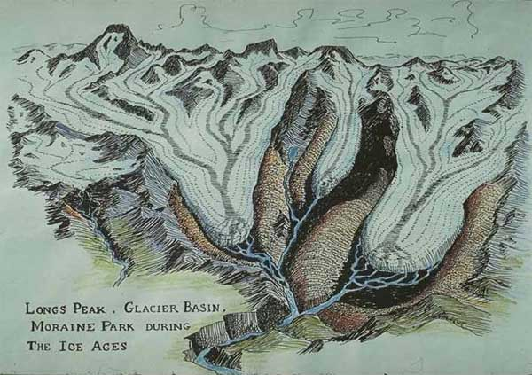
Much of the Front Range used to be covered in ice.
http://glaciers.research.pdx.edu/glaciers-colorado
Notes:
Colorado has 14 named glaciers, all in the Front Range. Most glaciers and snowfields in Colorado occur in east to north-facing cirques at high elevations near the ridge crests. These locations favor snow accumuliation from avalanches and windblown snow in winter, well-shaded from sun

Slide 21
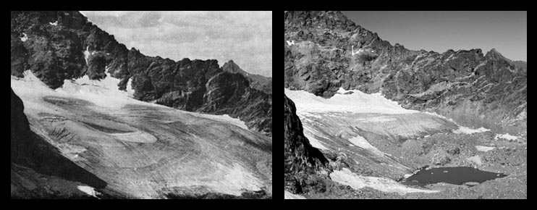
Unfortunately, our glaciers days are numbered…
1898
2003
Arapahoe Glacier
http://glaciers.research.pdx.edu/glaciers-colorado

Slide 22
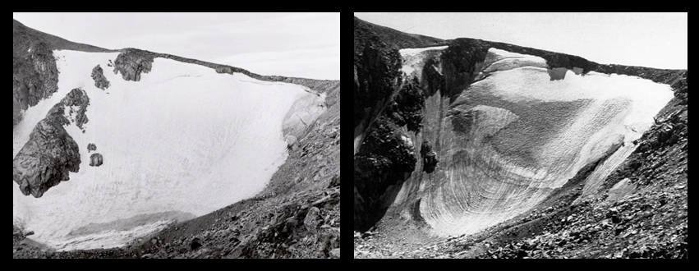
Unfortunately, our glaciers days are numbered…
1962
2000
Tyndall Glacier
http://glaciers.research.pdx.edu/glaciers-colorado

